Slide 1
Warm-Up
Consider the statements in front of you and determine whether you strongly agree, agree, disagree, or strongly disagree.
Briefly explain why you chose the stance that you did.
Notes:
I usually give students about 5 minutes to consider the three warm-up statements. The warm-up response sheet and 4 corners posters are included in the folder. I post the four corner response posters in 4 different corners of the room and read each statement one by one. Students are supposed to move to the corner of the room they stated on their paper. Once there, I call on a couple students to explain their view and why they selected the stance they did. You can also have students dialogue with their peers first before discussing as a class. Once you cover the first statement, read the second statement and repeat the process. Continue through all three statements. This activity is meant to be a introduction to the unit as a whole. It addresses a few important unit topics that you can refer back to when you cover them during the unit. It also gets students up and moving, while thinking about their views of the Judicial Branch. All in all, the warm-up usually takes about 15-20 minutes, depending on the depth of discussion.

Slide 2
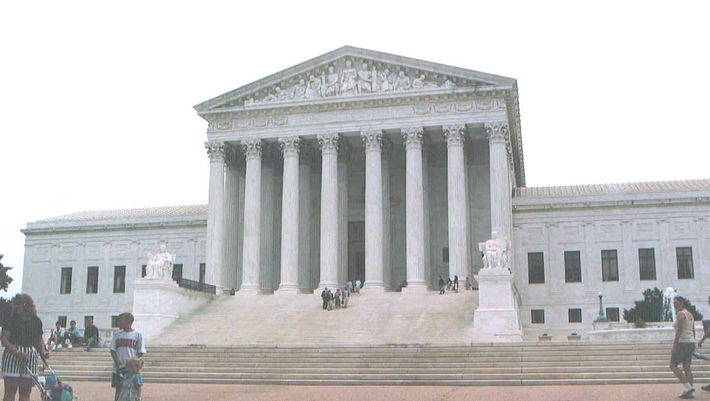
The Judicial Branch
Notes:
I have included cloze fill-in-the blank notes for students to follow along with during the presentation. These notes are designed as an introductory lesson for the Judicial Branch. It covers the role of the Judiciary, judicial review, and judicial philosophies.

Slide 3
Role of the Judicial Branch
Role: Interpret the law and uphold the US Constitution.
Need arose from the Articles of Confederation, which had no national judiciary.
Article III of the US Constitution lays out roles and responsibilities.
Notes:
I use this slide to review the role of the judicial branch and briefly review the roles of the executive and legislative as well. I emphasize the judicial branch’s power to interpret the law and to ensure the other branches are following the Constitution. I also review the government under the Articles and the fact that there was no one to settle disputes among the states, which was a key weakness. The judicial branch was an important change from the Articles to the Constitution.

Slide 4
Judicial Review
The court’s primary power: Judicial Review- the power to determine the constitutionality of laws or executive actions.
Judicial Review was established by the Court’s ruling in Marbury v. Madison.
Marbury v. Madison Video Clip
Notes:
I show the clip at the bottom of the slide to give the students some context about the case and its significance- it’s short and sweet, done by the History Channel. I would have the clip open before the notes for a smoother transition. I then check for understanding after the clip. I clarify that Article 3 of the Constitution lays the foundation for judicial review, but does not explicitly grant the power. Marbury v. Madison is really the first declaration and use of that power. Judicial review was not exercised until that case, making it extremely significant.
Marbury v. Madison Video Clip: https://www.youtube.com/watch?v=hOvsZyqRfCo

Slide 5
Famous Example of Judicial Review
Loving v. Virginia- argued over a Virginia law that prohibited interracial marriage.
The Court unanimously found that the law violated the 14th amendment.
Due to their power of judicial review and the precedent they set, all state laws prohibiting interracial marriage were effectively banned.
Video Clip: Loving v. Virginia
Notes:
There are countless examples of judicial review, but I have highlighted a historically significant example that had nationwide effects to illustrate the power of judicial review.
Video Clip Link: https://www.youtube.com/watch?v=q-qlS_J4Mho

Slide 6
How do Justices Interpret the Constitution?
It’s complicated to say the least.
Justices consider the following:
The text of the Constitution
Past precedents
However, few cases are clear-cut. The Constitution doesn’t address every issue we face, so it requires interpretation, which is subjective.
Different justices hold different views of interpretation.
Notes:
While all justices are to uphold the Constitution and should strive to be consistent in their decision making, judicial interpretation is not that simple. Justices have different interpretations depending on their judicial philosophies. For instance, some have a very strict interpretation and believe the courts are not there to legislate, while others believe they should use their power to correct past wrongs and enact justice with their position.

Slide 7
Consider: Judicial Philosophies
One of the biggest controversies surrounding the Judicial Branch is how justices are to interpret the law.
Some believe justices should interpret the Constitution based on the original intent of the Founders, while others believe justices should take into account societal changes and try to correct past wrongs.
Which philosophy do you believe is correct and why? Explain. Briefly write your thoughts in your notes.
Notes:
I give students about 5 minutes to answer the question. Then, we have a brief class discussion before the notes and video clip to see what their initial views are. If you are short on time, you can just ask the question and discuss without having students write their responses.

Slide 8
Judicial Philosophies
Judicial Restraint (original intent): View that the Constitution should be interpreted according to the original intent of the framers.
Tends to align with conservative views
Believes the courts are there to simply interpret, not write the law.
Common Criticism: Judges are stuck in the past, no room for considering societal changes.

Slide 9
Judicial Philosophies
Judicial Activism: View that argues judges should use their power broadly to further justice and apply present day values to their constitutional decisions.
Tends to align with liberal views
Believes the courts have a responsibility to right social wrongs.
Common Criticism: Judges tend to legislate and make decisions based on personal views.

Slide 10
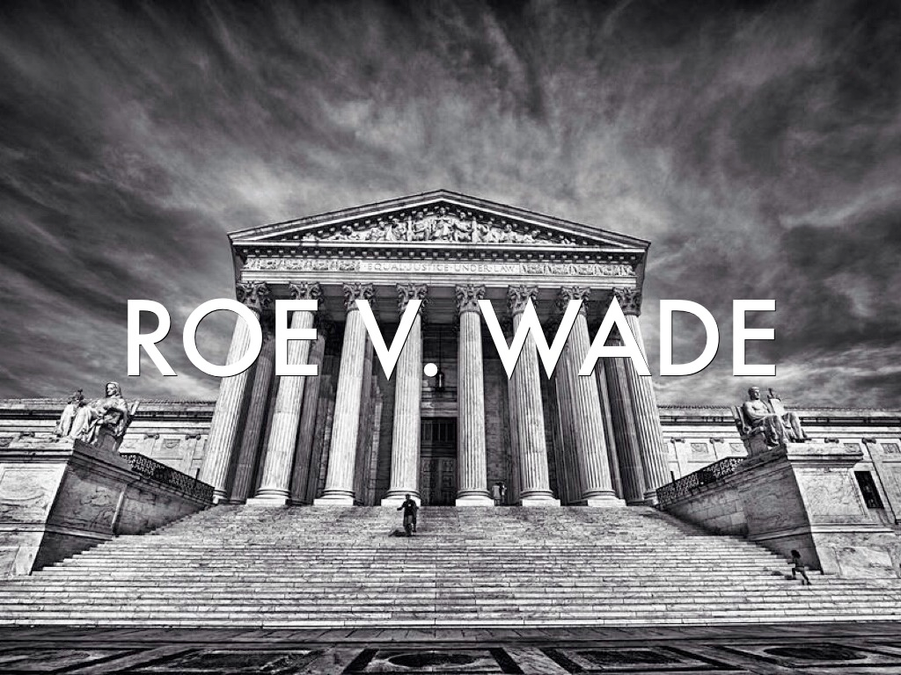
Example: Roe v. Wade
Directions: Read the excerpts from the majority and dissenting opinions and discuss the questions.
Regardless of your personal feelings about the topic of abortion, which judicial philosophy do you agree with and why?
Notes:
I have added this section if you’d like to take the time to do the extension activity. However, if you are short on time, you can always pass. The excerpts are in the folder.
Roe v. Wade is usually a pretty well-known case, but if you haven’t addressed it yet during class, you may want to give some context. After reading the excerpts, students should discuss the questions in small groups. I always recap the questions with them as well. In addition to the content discussed, I always make the point that the decisions focus on constitutional interpretation of the law, not moral views of abortion. The justices did not vote in favor of Roe, because they supported the practice of abortion, in the same way that those who voted against didn’t base their decision on their disapproval of the practice. It’s a good opportunity to point out the fact that justices are supposed to make decisions based on the law, not personal views, even though it sometimes doesn’t seem that way.

Slide 11
Different Views: Roe v. Wade
Judicial Restraint
Would argue that abortion is an issue for the legislatures, not the courts.
Roe v. Wade created a right to privacy not clearly laid out in the Constitution.
Judicial Activism
Would support the court’s decision- a right to privacy can be inferred through the Constitution and its amendments.
Notes:
This is just a follow-up slide to emphasize how supporters of the two different philosophies would likely see the decision.

Slide 12
Video Clip: Judicial Philosophies
The following is a clip from a 60 minutes interview with former Supreme Court Justice, Antonin Scalia.
Scalia was a firm believer in judicial restraint, or originalism. Consider his arguments, along with the views of his colleague, Ruth Bader Ginsburg, who adheres to judicial activism.
Clip: Scalia Interview- 60 Minutes
Notes:
This clip highlights former Supreme Court Justice, Antonin Scalia, who was known for his judicial restraint (originalism) view. It does a great job of explaining the restraint perspective. There is a brief section with Ruth Bader Ginsburg as well, who is a judicial activist, but the clip definitely centers on judicial restraint. I find that students are usually really engaged by the clip and have strong reactions, either positive or negative. It’s a great discussion piece. Please note: This clip is 13 minutes.
Video Link: https://www.youtube.com/watch?v=FrFj7JAyutg
If you have any issues with the link, just Google: Scalia 60 Minutes Part 1. The clip should be titled, “Justice Scalia On Life- Part 1”

Slide 13
Follow-Up Questions
1. Do you agree or disagree with Justice Scalia’s stance on originalism (AKA judicial restraint). Why or why not?
2. Did his arguments (or Justice Ginsburg’s) change your original stance?
3. Justice Scalia argued that the Court is there to impede change. Do you agree or do you believe the Court should help facilitate change?
Notes:
We usually have a pretty good follow-up discussion to this clip. Students usually either love or hate Scalia. Inevitably, usually some students change their minds after watching the clip, either due to Scalia or Ginsburg. I personally just do a discussion- no written response- but of course, you can do what you would like.

