Slide 1
Chapter 1 section 3

Slide 2
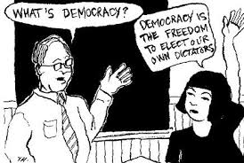
Democracy in the U.S.A
American democracy is characterized by core democratic ideals and principles, as well as by the free enterprise system.

Slide 3
Ideals of American Democracy
1. Liberty
2. Equality
3. Self Government
These have been put in place since the American Revolution and beginning of our country
Are in our founding documents: Declaration of Independence and Constitution
They guide our government today

Slide 4
Liberty
Ability of people to act and think as they choose
Choices must do no harm to the liberty or well-being of others
Freedom from government control
Freedom to exercise citizens’ rights guaranteed under the Constitution

Slide 5
Liberty

Slide 6
Equality
All people possess a fundamental, moral worth
Their worth entitles them to fair treatment and equal opportunity
Equality must be balanced with liberty to avoid despotism

Slide 7
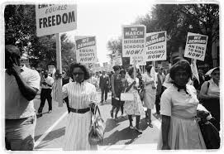
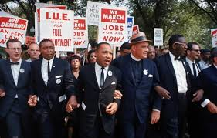
Equality

Slide 8
Self Government
All people can rule themselves and do so as political equals
People are the ultimate source of government authority
Governments derive their powers from the consent of the governed
People have a right to revolt against a government that has lost their consent

Slide 9
Principles of American Democracy
1. Worth of the individual
2. Rule of law
3. Majority Rule Minority Rights
4. Compromise
5. Civic Participation

Slide 10
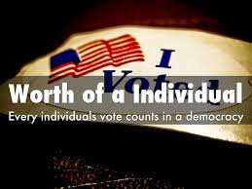
Worth of the Individual
Democracy values individual freedom, personal responsibility, self-reliance, and individual achievement
People can reach their highest potential if they pursue their own path

Slide 11
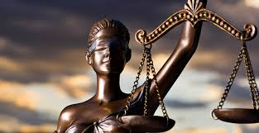
Rule of Law
U.S. government and officials are subject to limits on power
Limits are spelled out in the Constitution
“A government of laws, not of men”

Slide 12
Majority Rule Minority Rights
Decision making by majority rule, balanced by minority rights
Individual rights are protected under a liberal democracy
This means that the majority have the power but are required to listen to the minority

Slide 13
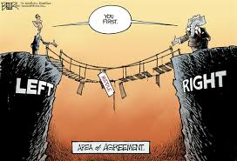
Compromise
Ability of two opposing groups to give up some demands and agree
Necessary to keep the political process moving

Slide 14
Citizen Participation
Citizens must be informed about public issues
Many ways to participate peacefully, respectfully, and with tolerance

Slide 15
Free Enterprise
Free enterprise allows both people and businesses to make their own economic choices
The government has limited involvement
Allows the individual to build wealth

Slide 16
Free Enterprise
The free market is essential in the United States
1. Open competition results in better products at a
lower price which helps the consumer
2. Those who succeed in the competition will prosper and make money
3. If businesses are successful and prosper it will benefit society and the economy

