Slide 1
Constitution REVIEW
Shannon Slaughter
Springville High School

Slide 2
Articles
of
Confederation
Government:
1781-1789

Slide 3
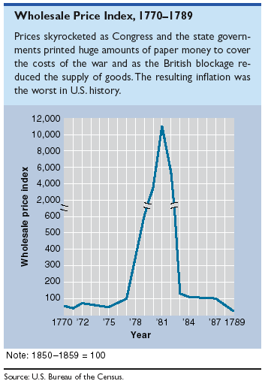
Wholesale Price Index: 1770-1789
Continentals – paper money issued by Congress to finance the war -- INFLATION

Slide 4
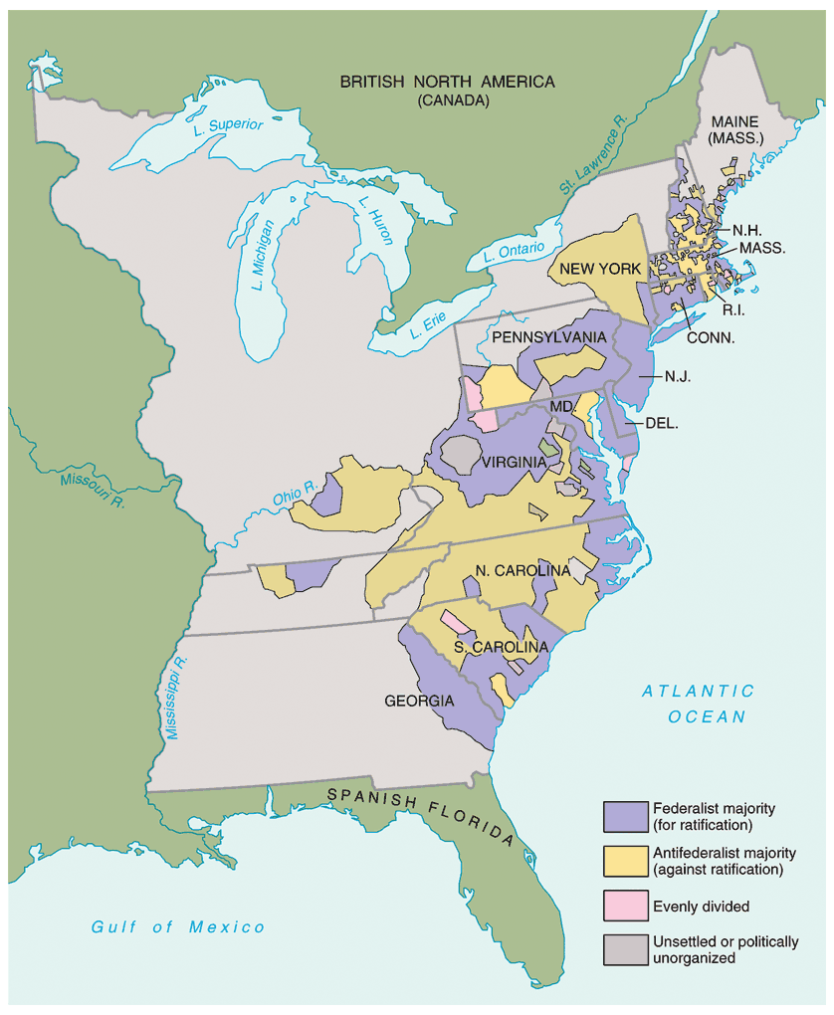
Federalist vs. Anti-Federalist Strongholds at the End of the War

Slide 5
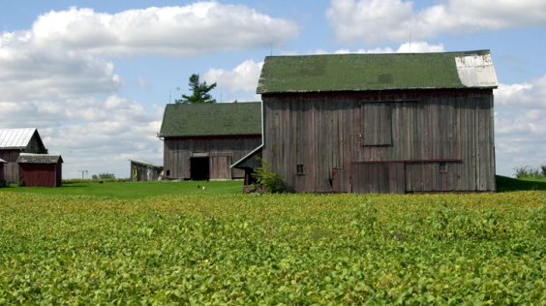
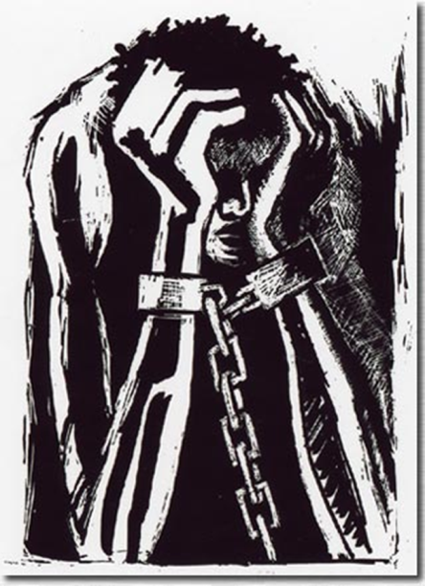
Equality in the states
Colonies
States
Voting limited only to property owning males
Most colonies western settlers were not represented
Supporters of aristocracy and traditional European values
More property was available after war, so most white males earned right to vote
Improved representation for westerners
Titles reflecting wealth and status used for all
Primogeniture and inheritance laws changed
Indentured servitude challenged
Early successes and failures with abolition
Steps to Abolition
1774 Rhode Island banned slavery
1775 Quakers create anti slavery society
Jefferson tried to include slave trade as a fault of King George, but southern states kept it out
Gradual emancipation began, especially in the north
Severe discrimination and segregation
Denied ability to own property, vote, hold certain jobs, marry, attend school

Slide 6
Republican Motherhood and Women’s rights
"I long to hear that you have declared an independency. And, by the way, in the new code of laws which I suppose it will be necessary for you to make, I desire you would remember the ladies and be more generous and favorable to them than your ancestors.
"Do not put such unlimited power into the hands of the husbands.
"Remember, all men would be tyrants if they could. If particular care and attention is not paid to the ladies, we are determined to foment a rebellion, and will not hold ourselves bound by any laws in which we have no voice or representation.
"That your sex are naturally tyrannical is a truth so thoroughly established as to admit of no dispute; but such of you as wish to be happy willingly give up -- the harsh tide of master for the more tender and endearing one of friend.
"Why, then, not put it out of the power of the vicious and the lawless to use us with cruelty and indignity with impunity?
"Men of sense in all ages abhor those customs which treat us only as the (servants) of your sex; regard us then as being placed by Providence under your protection, and in imitation of the Supreme Being make use of that power only for our happiness."
Abigail Adams chided husband John Adams “don’t forget the women”
“Civic Virtue” selfless commitment to public good was essential to republic
Mothers responsible for moral education of youth
Women seen as keepers of nation’s conscience
Educated women seen as better protectors of virtue
Women seen as vital to protection of republic

Slide 7
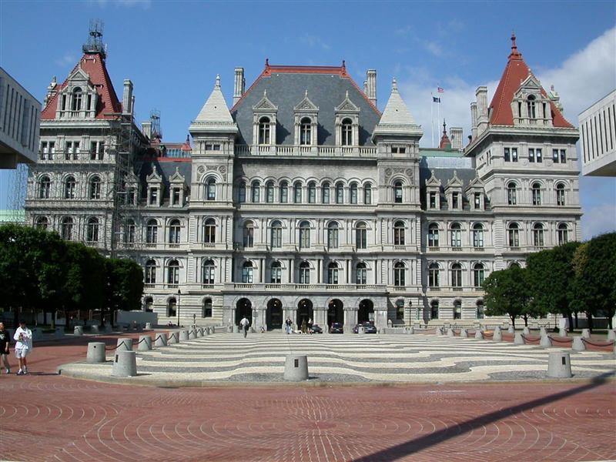
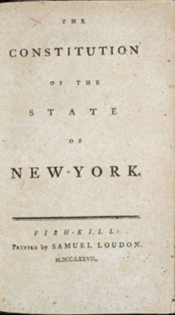
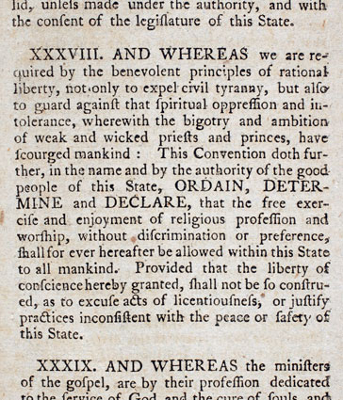
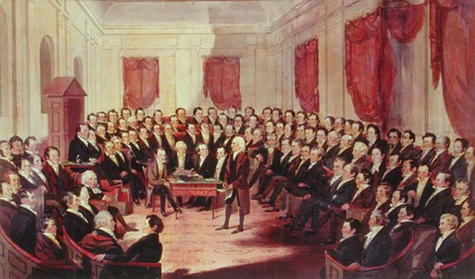
Constitution Making in States
1776 Continental Congress called on colonies to make state constitutions
Written frame of government for the states
English constitution was not one document, was several combined with tradition
Constitutions seen as fundamental – superior to ordinary legislation
State sovereignty comes from people
Most states kept versions of colonial governments
Some states just removed reference to the King
Just needed small changes to limit chances of tyranny
State Assemblies believed they had right to make Constitution since they were elected
New York State Capitol, Albany
Concord Protest (MA)
wanted special constitutional convention to write constitutions, not the regular assemblies
Massachusetts also submit final draft to people for approval
Precedent for National Constitutional Convention

Slide 8
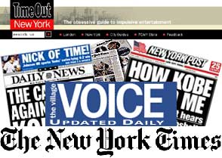
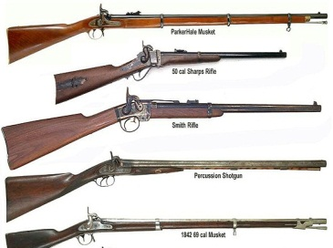
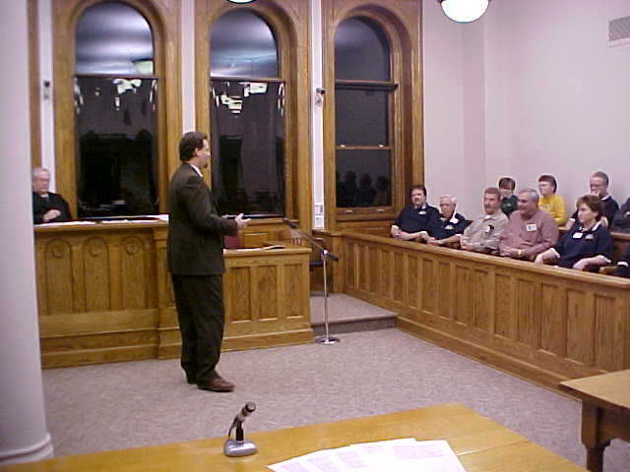
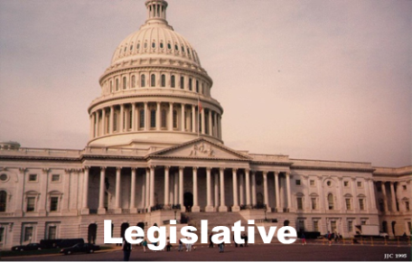
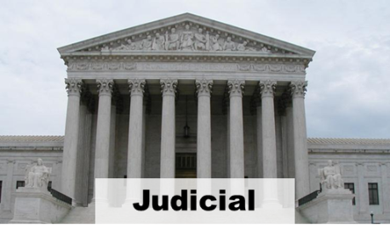
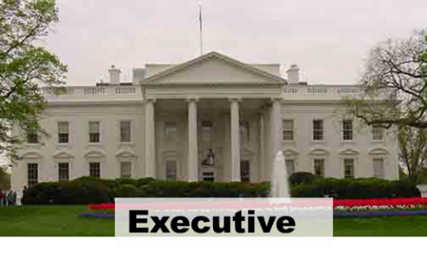
The new state constitutions
Began with declaration of independence
Declared bill of rights for citizens
Freedom of press, petition, from unreasonable searches, from standing armies, right to trial by jury
Most had two house legislature and a governor
Lower House members were elected
Required frequent reelection to insure closer connection between legislators and constituents
Limited power of governor (executive branch)
Couldn’t veto
Term limited
Could be impeached
Judicial and Executive branches were intentionally kept weak

Slide 9
Economic Opportunity
Royal and Loyalist’s lands were taken over by the States
Some land was made available to the people, which prevented radicalization or continuation of revolution by the lower classes
American manufacturing was stimulated through non-importation agreements
America lost access and protection of Britain
Navigation laws prevented American trade with British colonies
But began trading globally from Baltic to China
Profiteering and inflation destabilized infant American economy
British manufactures dumped products on American markets making survival of American businesses difficult

Slide 10
Difficulties Establishing National Government
“Natural Rights” and revolutionary distrust of government caused distrust of all authority
There was much disunity between colonies that was muted while fighting the “Common Cause”
States saw national government as a rival
Did not want national government to dominate states
Government is agreement among states, did not represent people, state governments did that

Slide 11
Foreign Policy Issues
Britain
did not give up forts in American territory
British claimed they kept forts until Loyalist property returned
Refused to send political ambassador to United States
Refused to make trade agreements with US
Lord Sheffield and others believed trade would naturally resume
Spain
denied US access to New Orleans
Claimed Florida as well as southern AL
and MS
Both British and Spanish gave money
and weapons to Indians
France
Demanded repayment of war debts
Closed trade to West Indies
Barbary Pirates
Dey of Algiers had American sailors
kidnapped and pirated American ships
American ships used to be protected
by British

Slide 12
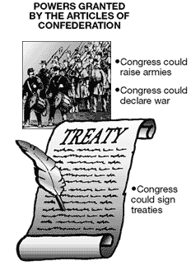
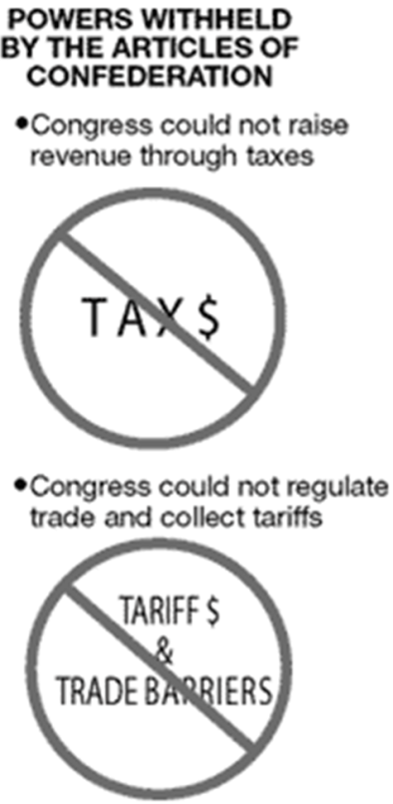
Articles of Confederation
Adopted by 2d Continental Congress in 1777, ratified by states in 1781
kept most power in states
One vote given per state
9 of 13 states needed to pass laws
13 of 13 needed to amend the agreement
No provision for courts or president
Congress COULD:
Make treaties
Settle problems between states
Create admiralty courts
Make and borrow money
Trade with Indians
Congress COULD NOT
Force states to pay taxes
Enforce its decisions
Regulate commerce or make tariffs

Slide 13
Weaknesses of the Articles of Confederation
A unicameral Congress [9 of 13 votes to pass a law].
13 out of 13 to amend.
Could not regulate INTERstate commerce
Representatives were frequently absent.
Could not tax or raise armies.
No executive or judicial branches.

Slide 14
State Constitutions
Republicanism.
Most had strong governors with veto power.
Most had bicameral legislatures.
Property required for voting.
Some had universal white male suffrage.
Most had bills of rights.
Many had a continuation of state-established religions while others disestablished religion.

Slide 15
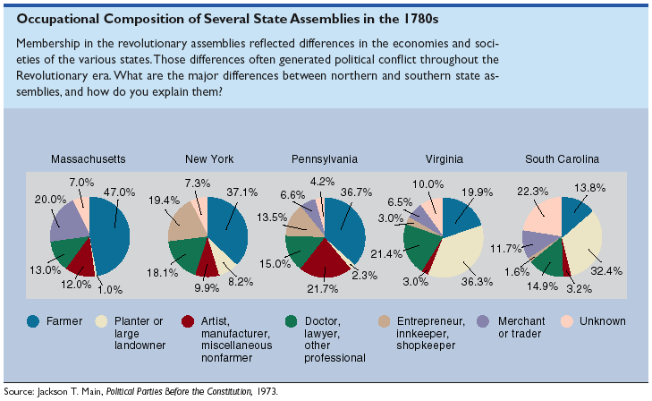
Occupational Composition of Several State Assemblies in the 1780s

Slide 16
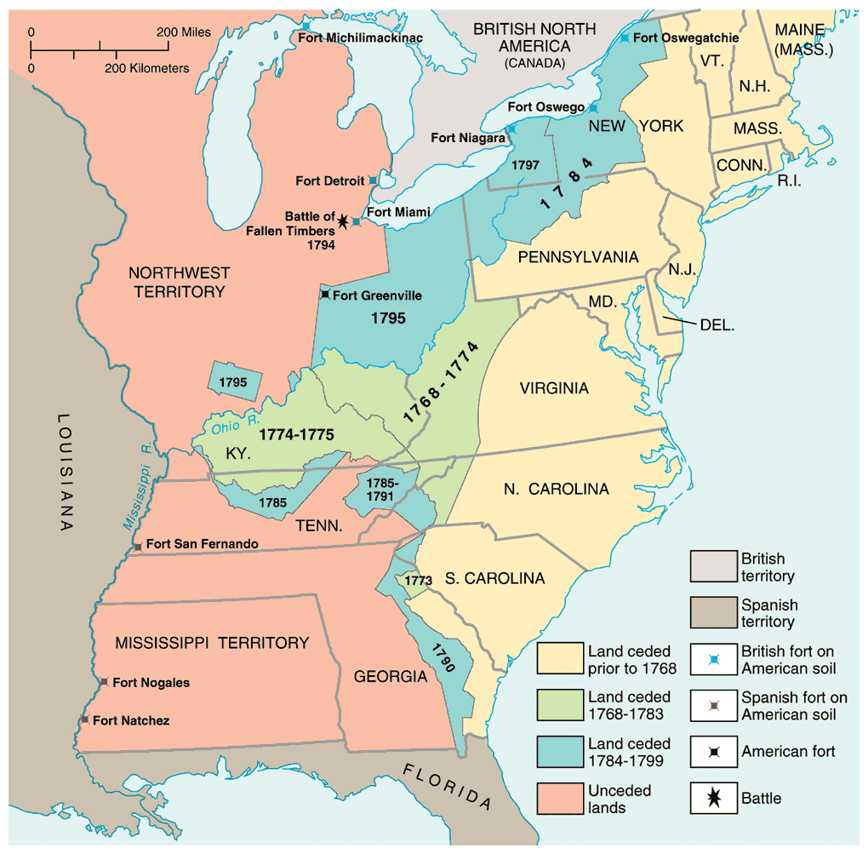
Indian Land Cessions: 1768-1799

Slide 17
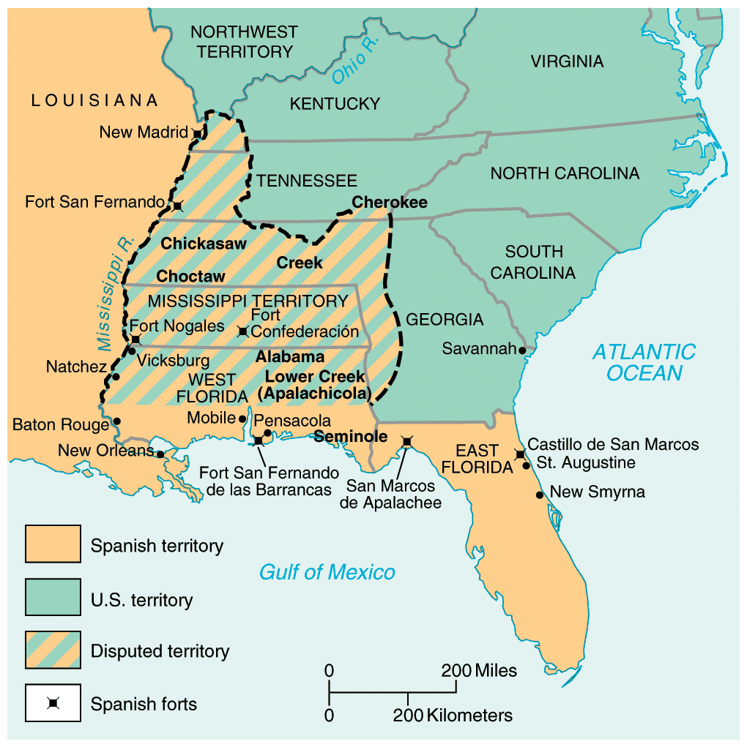
Disputed Territorial Claims Between Spain & the U. S.: 1783-1796

Slide 18
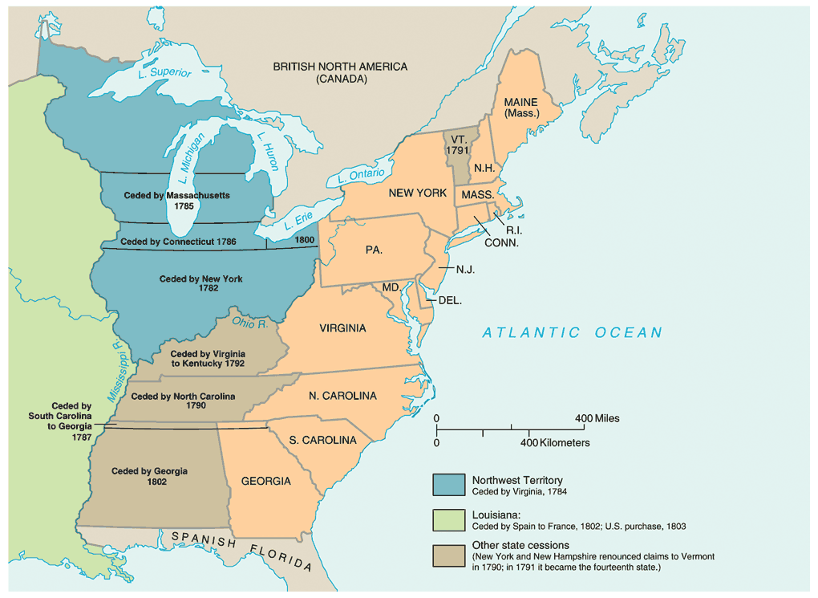
State Claims to Western Lands

Slide 19
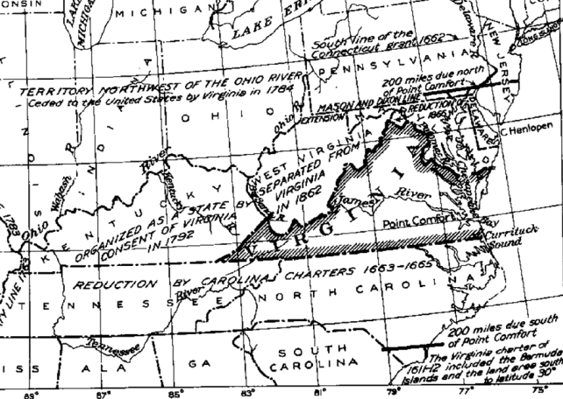
Western Lands
Many states claimed land from “sea to sea”
Many lands were claimed by more than one state
Maryland and small states with no land demanded all land in trans-Appalachian west be given to national government
feared western land would make some states too powerful
Virginia agreed to give up land claims
in exchange for a central government
as long as new territories were guaranteed same rights as existing states
Sale of western lands used by national government for money
Because national government couldn’t tax
Articles of Confederation required unanimous support to become effective
Once New York and Virginia surrendered land, Maryland approved Articles and it had unanimous support

Slide 20
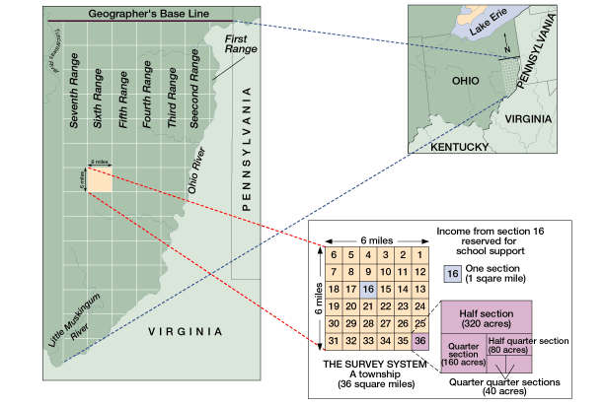
Land Ordinance of 1785
~ Land of Northwest territory was to be sold to pay national debt
~Laws to survey and organize western lands
~Townships of 6 mile square grids created
Each township divided into 36 parts,
One reserved for school, four for government, the rest sold
Led to orderly, organized settlement of area

Slide 21
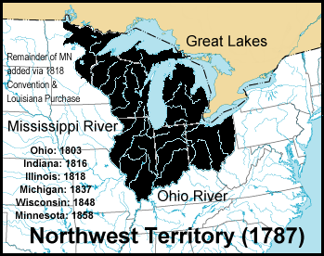
Northwest Ordinance of 1787
One of the major accomplishments of the Confederation Congress!
Statehood achieved in three stages:
Congress appointed 3 judges & a governor to govern the territory – excluded slavery and protected rights to – a)freedom of religion b)trial by jury c)to own property
When population reached 5,000 adult male landowners → elect territorial legislature.
When population reached 60,000 → elect delegates to a state constitutional convention.

Slide 22
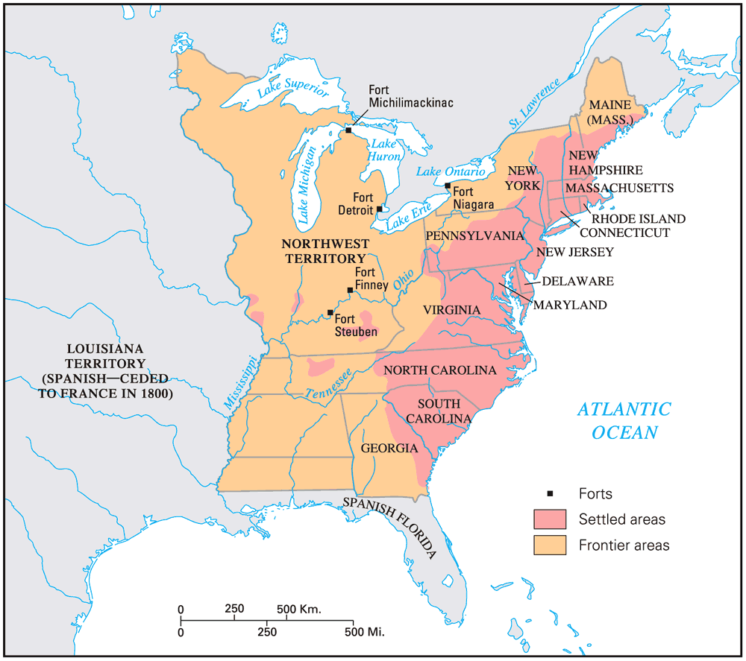
The United States in 1787

Slide 23
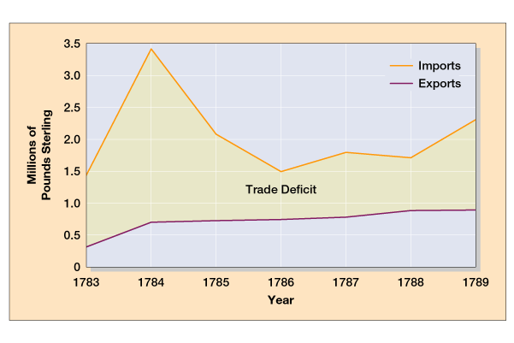
American Exports, To & From Britain: 1783-1789

Slide 24
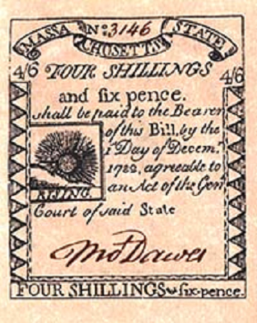
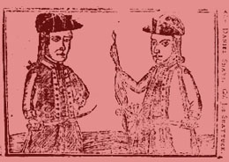
Shays’ Rebellion: 1786-7
Daniel Shays
Western MA
Small farmers angered by crushing debts and taxes.
Massachusetts refused to print more money – which makes it available to poor people
Believed government was favoring the wealthy

Slide 25
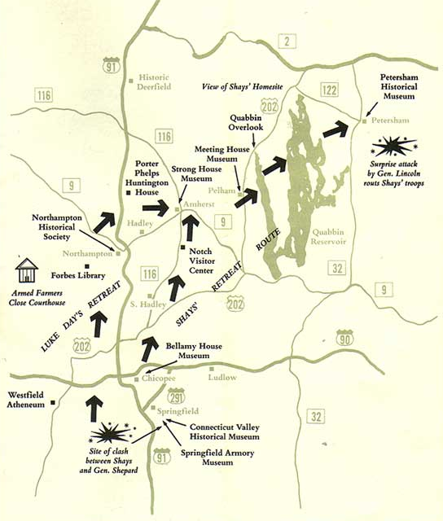
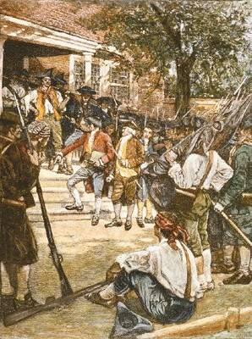
Shays’ Rebellion: 1786-7

Slide 26
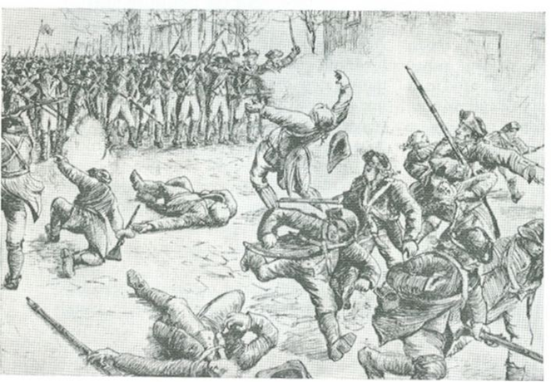
Shays Rebellion (1786)
End of war led to overproduction of crops
Result in devaluation of crops
Farmers did not have gold to pay debts when paper money refused
were jailed or lost land when couldn’t pay debt
Farmers revolted led by Daniel Shays
Demanded paper money, lighter taxes, suspension of repossession of farms
State did not want to help debtors and hurt creditors
Massachusetts militia ended revolt
After victory, MA government did pass some debtor relief laws
Effect of Shays Rebellion
Scared propertied class nationwide
“mobocracy” would allow pursuit of
individual gain to dominate government
instead of civic virtue
National government could not stop it
Led to call for stronger national government

Slide 27
Result of Shays’ Rebellion?
Constitutional delegates realize the weaknesses of the Articles of Confederation
Difficulty in having a professional army ready to put down rebellions
Class division in America is greatly exposed
Makes it easier for the rich and powerful to “SELL” a strong federal government – Protection of the people

Slide 28
Annapolis Convention (1786)
12 representatives from 5 states [NY, NJ, PA, DE, VA]
GOAL → address weaknesses of the Articles of Confederation that limited trade and commerce between the states.
Not enough states were represented to make any real progress.
Sent a report to the Congress to call a meeting of all the states to meet in Philadelphia to examine areas broader than just trade and commerce.

Slide 29
Constitutional Convention 1787 Philadephia, PA
Purpose – address the problems of Articles of Confederation and REVISE it
Representation – for tax purposes and voting
Power of Executive Branch / Judicial Branch / Legislative Branch
Elect the President / terms / re-elections
Fugitive Slave Law
Abolishment of slavery

Slide 30
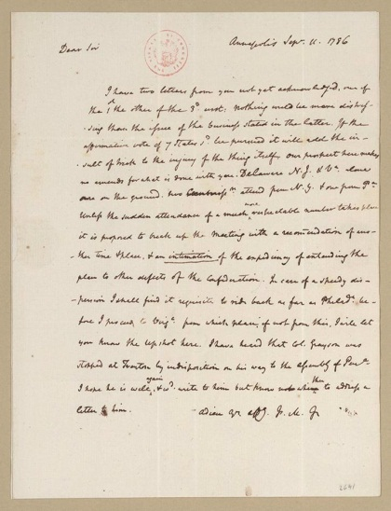
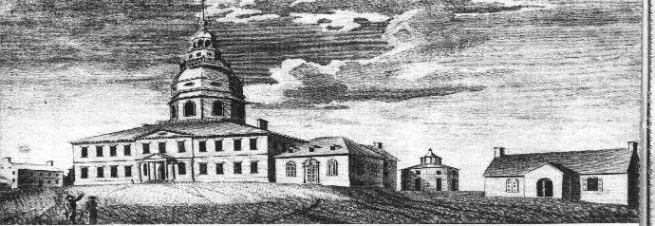
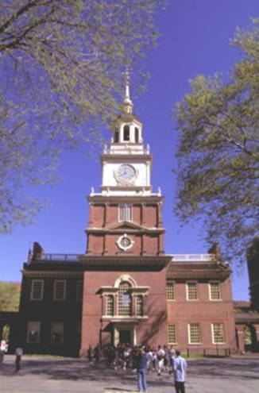
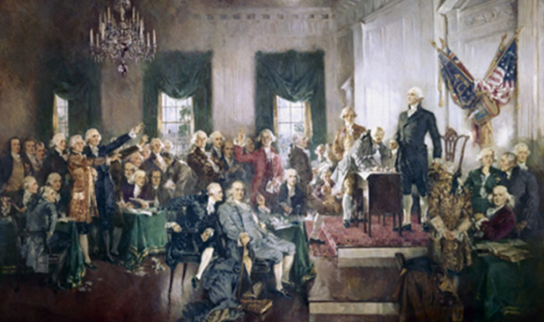
Annapolis Meeting (January 1786)
Virginia called for a meeting to regulate commerce
9 states appointed delegates, only 5 states showed
Alexander Hamilton called for a larger convention to rework the entire Confederation
Letter from Madison to Monroe 1786
Maryland State House
Constitutional Convention May 25, 1787
All states except Rhode Island came
Purpose of the meeting was vague
55 delegates, appointed by state legislatures
Propertied, educated men
Most delegates were ready to find compromise solutions
Many had experience making state constitutions
George Washington, Benjamin Franklin, James Madison, Alexander Hamilton, Gouverneur Morris were central figures
Most were NOT former Revolutionaries

Slide 31
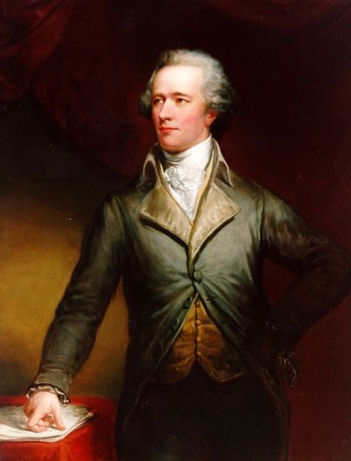
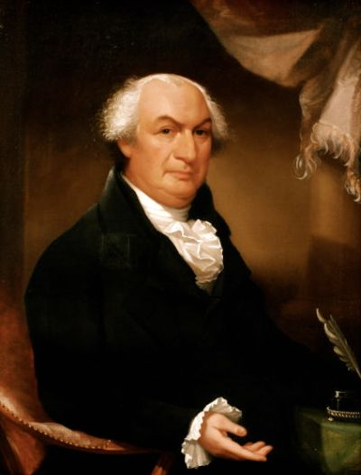
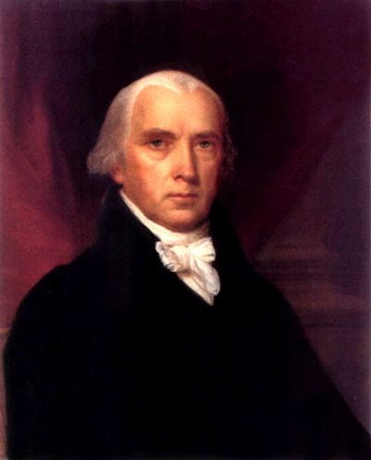
Patriots in Philadelphia
55 delegates
Lawyers, merchants, shippers, land speculators and money lenders
No one from debtor groups
19 slaveowners
Young but experienced politicians
Were all nationalists – wanted to strengthen unity
Wanted genuine power in national government
Use tariffs to improve commercial treaties with other nations
But power should be limited
Opposed democracy or “mobocracy”
Fear justified from Shay’s Rebellion
Intended to eliminate Articles of Confederation and replace it
Patrick Henry did not participate because he “smelled a rat”
Alexander Hamilton
Gouverneur Morris
James Madison

Slide 32
Need for compromise
States did not want to give up power, afraid of creating another abusive central government
States had different and contrary needs
Small states feared being dominated by large ones
George Washington and Benjamin Franklin helped keep meeting on track
James Madison kept notes of the meetings

Slide 33
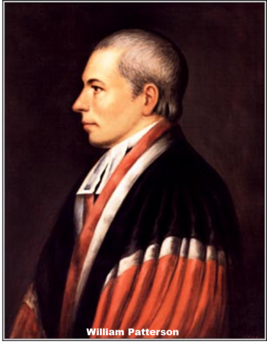
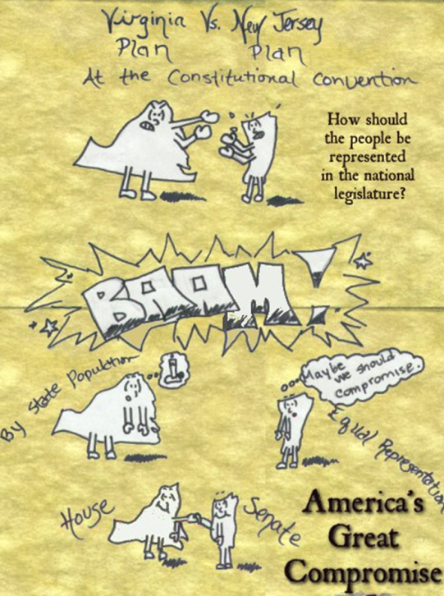
Great Compromise
Virginia Plan
Proposed by E. Randolph
Two house legislature
Representation based on population
New Jersey Plan
Proposed by William Patterson
One house legislature
Representation equal for each state
Connecticut Compromise or Great Compromise
Two house legislature
One house would be equal representation (Senate)
One house would be based on population (House of Representatives) – 1 REP per 30,000 citizens
All tax legislation must start here

Slide 34
The Confederation and the Constitution
Chapter 7

Slide 35
Annapolis Meeting (January 1786)
Virginia called for a meeting to regulate commerce
9 states appointed delegates, only 5 states showed
Alexander Hamilton called for a larger convention to rework the entire Confederation
Maryland State House
Letter from Madison to Monroe 1786
Constitutional Convention May 25, 1787
All states except Rhode Island came
Purpose of the meeting was vague
55 delegates, appointed by state legislatures
Propertied, educated men
Most delegates were ready to find compromise solutions
Many had experience making state constitutions
George Washington, Benjamin Franklin, James Madison, Alexander Hamilton, Gouverneur Morris were central figures
Most were NOT former Revolutionaries

Slide 36
DRAFTING OF THE U.S. CONSTITUTION

Slide 37
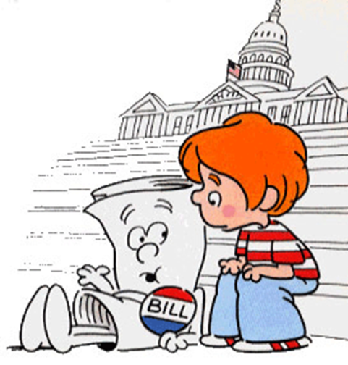
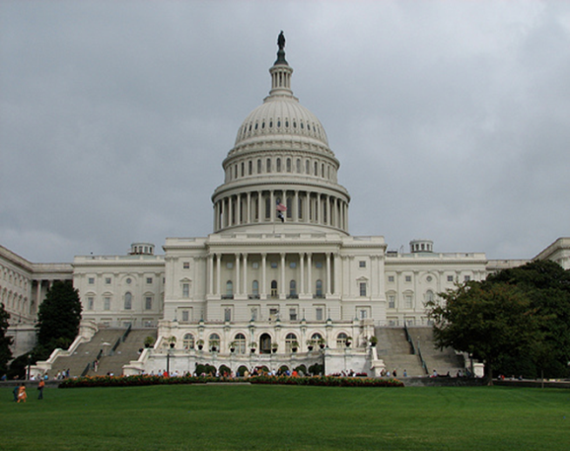
Legislative Branch
House of Representatives
Elected on 2 year terms
Number of Representatives per state based on population
Senate
Elected on 6 year terms
Every state gets 2 senators regardless of population
Congress
Makes laws
Making taxes and tariffs
Declare war
Coining money
Post offices
Necessary and Proper (elastic clause)
constitution allows for any laws to be passed that Congress needed to carry out its functions

Slide 38
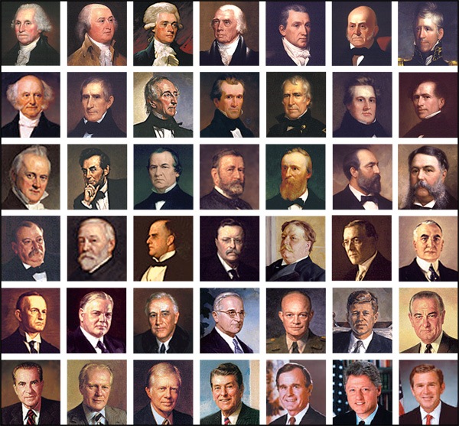
Executive Branch
Framers wanted strong executive
Inspired by Massachusetts governor’s response to Shay’s rebellion
Presidential powers:
Appointments to domestic offices
Appointments of federal judges
Commander in Chief of military
Gave power to wage war
Negotiate treaties

Slide 39
Electoral College
Framers distrusted direct democracy
Wanted Electoral College as protection
Electoral College vote determines Presidency, not popular vote
Initially gives advantage to larger states because electors are assigned at a number equal to Senators + Representatives
If no candidate gets majority election goes to House
Each state gets one vote in House – gives advantage to small states
Assumed achieving a majority of electoral votes would be difficult
2004 election
2000 Election

Slide 40
Three Fifths Compromise
South wanted slaves be counted for determining population for representation
North wanted slaves to be counted for determining taxation
Decided 3/5 of slaves would be counted.

Slide 41
Commerce Compromise
1807

Slide 42
Structure of Government
Three Branches of government
Executive
Legislative
Judicial

Slide 43
Checks and Balances
Limited powers of different branches
President could negotiate treaty, Congress has to ratify
President can appoint officials, Congress must approve
Only House can start bills regarding taxes, only Senate ratifies treaties

Slide 44
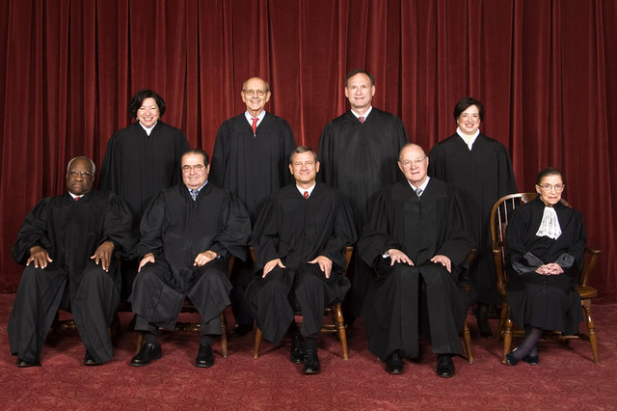
Judicial Branch
Supreme Court
Justices Appointed for life
9 Justices on the Court
Chief Justice Roberts
Justices Scalia, Kennedy, Thomas, Ginsberg, Breyer, Alito, Sotomayor, Kagan
Made to hear all cases resulting from constitution
Can declare laws and actions unconstitutional

Slide 45
Powers given in Constitution
National Government
State Governments
Powers granted:
Tax, control commerce, raise army and navy, conduct foreign relations
Powers Denied
Bills of Attainder
Declaring guilt without a trial
Ex Post Facto laws
Make an act a crime after it has been committed
Export Taxes
Titles of Nobility
Powers granted:
Make laws over daily life, anything not mentioned in the Constitution
Powers denied
Treaty making
Coining money
Bills of attainder
Ex Post Facto laws
Levy duties on imports
Entering into agreements without Congressional approval

Slide 46
Amendment process
Allowed for changes to Constitution
Process intentionally made cumbersome and slow to reduce political, emotional or reactionary changes

Slide 47
GO TO THE NEXT POWER POINT TO FIND OUT HOW THE CONSTITUTION WAS ACTUALLY ADOPTED IN THE U.S. -- THERE WAS A MAJOR STRUGGLE BETWEEN THE FEDERALISTS AND ANTI-FEDERALISTS

