Slide 1
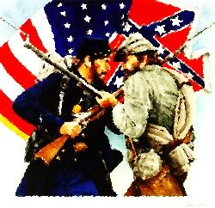
.

Slide 2
Bell Ringer Bibliotherapy Lesson
Completely answer the following questions after reading Pink & Say.
In your own words, what does the word risk mean?
Can risk taking be both positive and negative? Why?
How is Pinkus “Pink” Aylee “introduced” to Sheldon “Say” Curtis?
What special talent did Pink have and how did he get it?
Why is Say really afraid?
Why does Pink feel empowered to say that “no one really owns me”?
How does Moe Moe Bay approach Say’s feelings of cowardice?
What would you have done if you had been Pink? Say? What choices did the boys have, if any?

Slide 3
Long Term Causes
Economics – High Tariffs that harmed the South more than the North (Tariff of 1816 / 1828 / 32) More diverse economy in the North / Agriculture in South
Slavery – the founding of America as a slave nation
Inability to Compromise – government was founded on it
Difference in culture between North and South
States’ Rights – found in VA, KY Resolutions (Nullification) / Webster v. Hayne Debate / Hartford Convention
South Carolina Nullification Crisis

Slide 4
Advantages of the Confederacy
Better Military Leadership –
Military Tradition of the South
Great Generals / fighters
Home-field Advantage –
Fighting a defensive war / knew the territory
Better Marksmen / Scouting –
Spy Network
Small game hunting

Slide 5
Advantages of the Union
Larger Population – 22 million vs. 11 million / more men to fight with
More $$$$ -- for paying soldiers / weapons / etc
RR Track – more miles for transport
NAVY
Industry – Factories
Banks – for loans to the Government
Food – crops – South had cash crops
Martial Law – 2 states – Maryland and Kentucky WHY?
Border states didn’t join – Missouri, Delaware

Slide 6
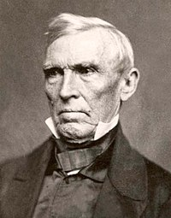
1860 – CRITTENDEN COMPROMISE
Last ditch effort at peace in Congress
Guaranteed the permanent existence of slavery
slave states
addressed Southern demands in regard to fugitive slaves and slavery in the District of Columbia
Proposed extension of the Missouri Compromise line
west, with slavery prohibited north of the 36° 30’ parallel and guaranteed south of it
Approved in 1861 – means the war is being fought to PRESERVE THE UNION and NOT to END SLAVERY

Slide 7
Union “Anaconda Plan”
3 pronged Union attack to defeat the Confederacy
Blockade the Coastline
Divide the Confederacy
Capture the Capital (Richmond)

Slide 8
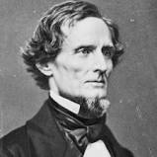
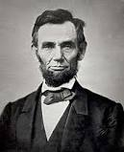
Political Leaders
Confederacy - Davis
Union - Lincoln

Slide 9
Military Leaders
Confederacy
Union

Slide 10
1861 – (April 12) Ft. Sumter, SC
Following the secession of the Deep South – Ft. Sumter is technically in enemy hands (the Union)
The commander of Ft. Sumter (Major Gen. Robert Anderson) ordered all of his troops that were in the town of Charleston back out to the fort. (68 total)
SC Militia moved to quickly surround the fort with artillery from Charleston.
Lame Duck President James Buchanan ordered the fort to be resupplied. The supply ship turned back.
Davis and Lincoln are inaugurated by their respective countries

Slide 11
Sumter Dilemma
Fort Sumter needed resupplying.
If Lincoln sent a ship / it makes the Union look like the aggressor. If Davis attacks the fort it makes the Confederacy look like the aggressor.
States that had not seceded (VA & NC)
Davis sent Confederate delegates to Washington to get Lincoln to surrender the fort. (They are refused)
Lincoln decides to resupply the fort.
Davis orders the fort to be attacked.
Results – no casualties except a horse. / LINCOLN ORDERS 75,000 troops to be brought to Washington, DC for the purpose of putting down the “aggressors” in the South.
Virginia and North Carolina SECEDE. (11 total Confederate States)

Slide 12
Fort Monroe, VA
Union General Benjamin Butler
Fugitive Slaves are “Contraband of War”
CONFISCATED PROPERTY
WOULD NOT BE RETURNED TO THEIR OWNERS
VIOLATION OF FUGITIVE SLAVE LAW (Federal)
Union Regiments will eventually seize contraband slaves and employ them in the Union Army though mostly as cooks, laborers, etc

Slide 13
Confiscation Act
Confiscation of any of property being used to support the Confederate independence effort, including slaves
did not clarify whether the slaves were free
Came under the supervision of the US Army
Army freed all slaves under their command – Lincoln countermanded this order thus making the contraband slaves property of the US Government
Border states (KY, MD, MO, DE) typically returned the slaves to their former masters until Congress forbid it in 1862

Slide 14
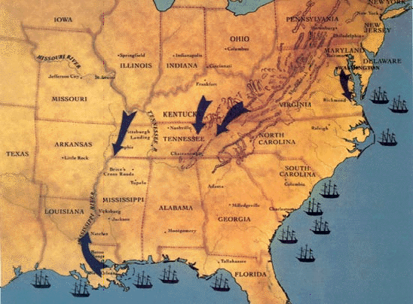
UNION invasion 1861
UNION invasion 1862
UNION campaign to control Miss. River - 1861
UNION blockade of Southern ports

Slide 15
Bell Ringer 4/17/2017
Why did R.E. Lee refuse the promotion?
Why did Lincoln rush to call up 75,000 volunteers following Ft. Sumter?
Did Lincoln really deepen the crisis or was he merely making a move to protect his country (USA)?
Why is Lee surprised about Lincoln’s call for volunteers?
What did the speaker at the VA House of Burgesses mean by the USA “imposing its will through coercion?”

Slide 16
1861 – 1st Battle of Bull Run – Manassas, VA
After Ft. Sumter, Lincoln had called up 75,000 volunteer troops to began training for war
Union General – Irvin McDowell – Army of East VA / later to be named ARMY OF THE POTOMAC
Confederate General – P.G.T. Beauregard / with assistance from Brig. General Joseph Johnston and Thomas J. “Stonewall” Jackson
Union Politicians in Washington brought out their children/ picnic baskets / etc. to watch a grand old battle

Slide 17
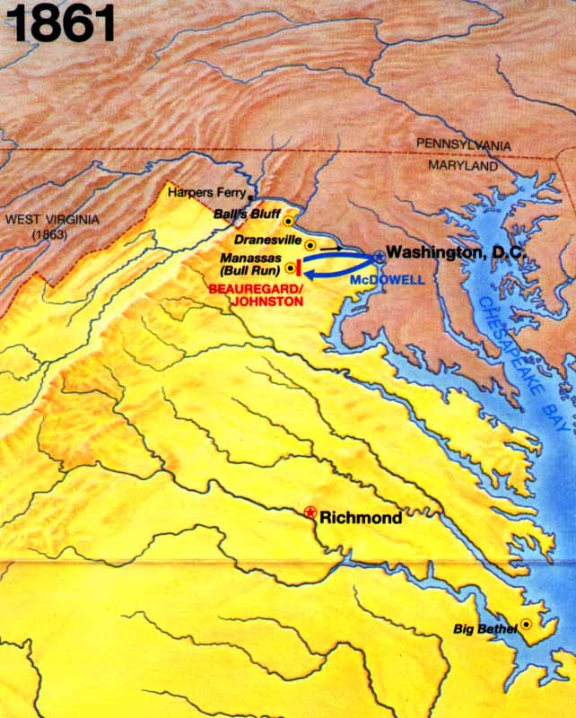
Map of attempted Union invasion of the Confederacy at Manassas Junction, Virginia

Slide 18
1861 – 1st Battle of Bull Run
Union was winning the battle
Thomas Jackson’s VA Brigade comes up in support of Gen. Barnard Bee -- The Enemy are driving us," Bee exclaimed to Jackson. Jackson, a former U.S. Army officer and professor at the Virginia Military Institute, is said to have replied, "Then, Sir, we will give them the bayonet."[18] Bee exhorted his own troops to re-form by shouting, "There is Jackson standing like a stone wall. Let us determine to die here, and we will conquer. Rally behind the Virginians.”
“Great Skedaddle”
Jackson reportedly asked Jefferson Davis for 10,000 fresh troops so he could take Washington D.C.
Davis declined and the Confederate Army retreated back into VA – DEFENSIVE WAR
BATTLE RESULTS –
UNION – REALIZES THEY MUST WORK HARDER BECAUSE THE CONFEDERACY IS NOT GOING TO BE EASY TO DEFEAT
CONFEDERACY – COMMON EVERYDAY SOLDIER GETS SUPREMELY OVERCONFIDENT AS DOES THE RICHMOND LEADERSHIP

Slide 19
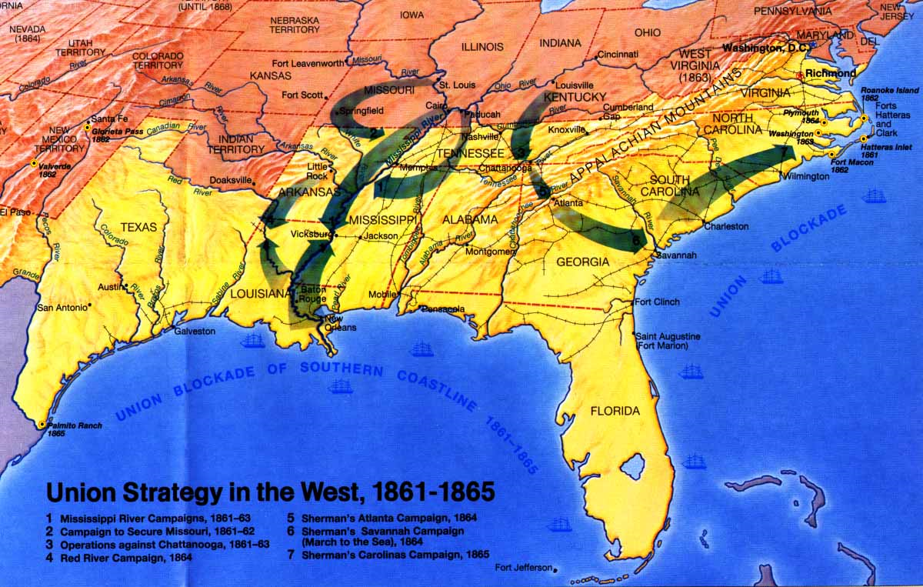

Slide 20
TWO BROTHERS SONG ANALYSIS
One wore blue and one wore grey As they marched along the way A fife and drum began to play All on a beautiful morning One was gentle, one was kind One came home, one stayed behind A cannonball don't pay no mind All on a beautiful morning A cannonball don't pay no mind Though you're gentle, though you're kind It don't think of folks behind All on a beautiful morning Two girls waiting by the railroad track For their darlings to come back One wore blue, and one wore black All on a beautiful morning

Slide 21
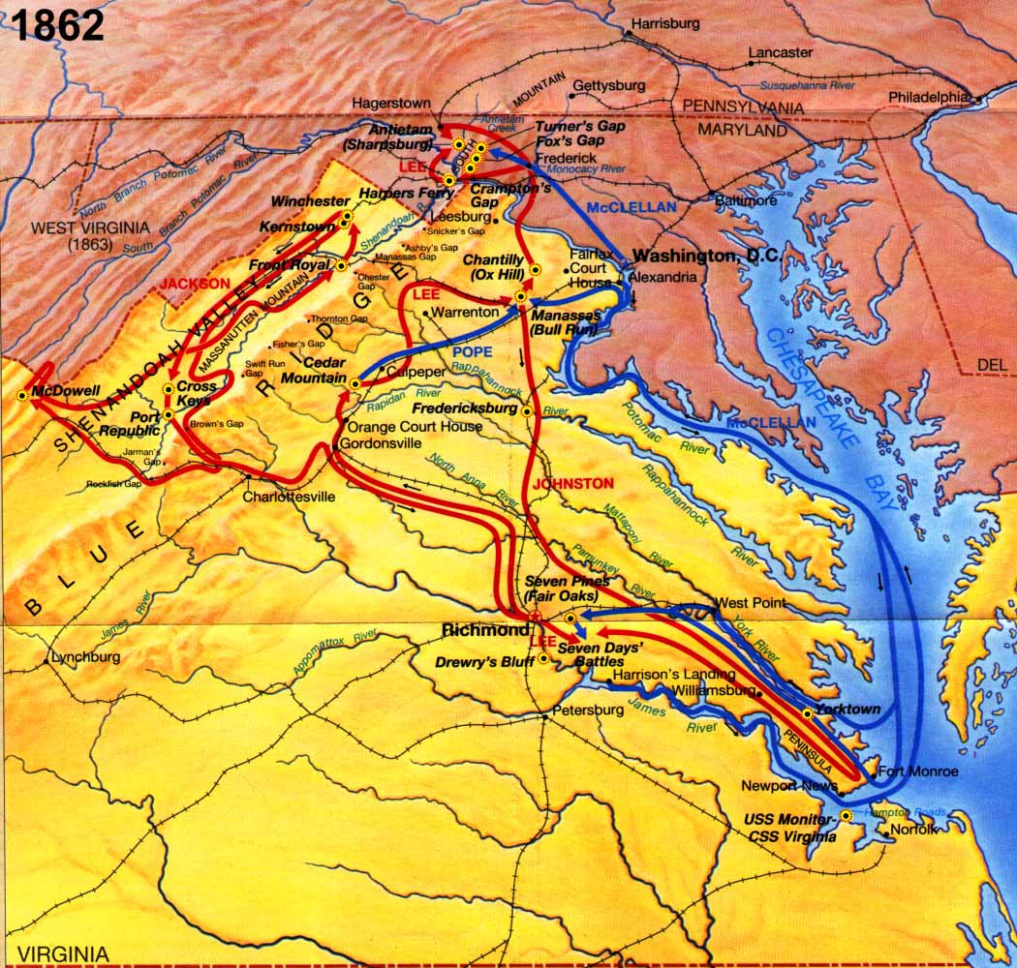

Slide 22
1862 – Peninsula Campaign
Union leaves the comfort of Washington D.C. (Lincoln is happy -- “If General McClellan isn't going to use his army, I'd like to borrow it for a time." )
George McClellan placed in charge of the Union Army of the Potomac but is reluctant to fight – always asks for more men before he attacks the enemy
Finally moves the Army of the Potomac up the Peninsula in Virginia

Slide 23
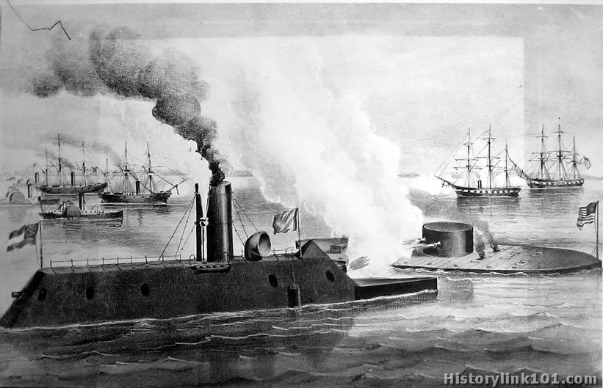
1862 – USS Monitor v. CSS Virginia (MERRIMACK) –Battle of Hampton Roads, VA

Slide 24
Monitor vs. Merrimack
Controversy – called the “Yankee cheesebox” – many thought it would not float because of its completely iron-laden design – Lincoln overruled
CSS Virginia was having success against the Union battleships that had been chosen to protect the Chesapeake Bay
On the second day of the battle – THE MONITOR arrived
The 2 Ironclads battled each other to a draw and eventually the CSS Virginia limped back to its docking port in VA – they never fought again / the Union blockade was not defeated
Battle of the IRONCLADS
Confederate attempt to break through the Union blockade (Anaconda Plan)
CSS Virginia had been built from remnants of the USS Merrimack, hence the name (winners write history)
Union intelligence discovered the confederacy was building an ironclad warship so they began to build– USS Monitor
Designer John Ericcson guaranteed it could be built in 100 days – 101
Union needed it because the CSS Virginia started to crash the blockade on day 103

Slide 25
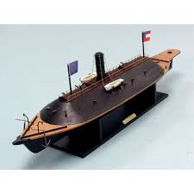
Monitor and Virginia
USS MONITOR
CSS VIRGINIA (Merrimack) – note the wooden hull that ran under water

Slide 26
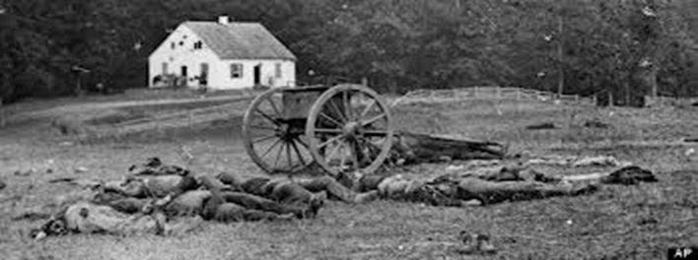
1862 – Battle of Antietam Creek, MD
Significance –TURNING POINT BATTLE OF CIVIL WAR – DRAW
Army of Potomac – 75,000
Army of Northern VA – 55,000
1st time Confederacy abandons their DEFENSIVE strategy – searching for food
Union could have ended the war – McClellan found Lee’s battle plans wrapped in cigar papers left behind
Robert E. Lee (General of the Army of Northern Virginia
After this battle Lincoln issued the EMANCIPATION PROCLAMATION – (needed a victory first)
Lee had split his troops (cardinal rule) /Hagerstown, MD and Harpers Ferry, VA
Jackson / Stuart foraging for supplies and food
McClellan did nothing for 18 crucial hours and finally attacked
Lee was back at full strength by then
Bloodiest single day of war in US History
23,000 casualties (both sides combined)

Slide 27
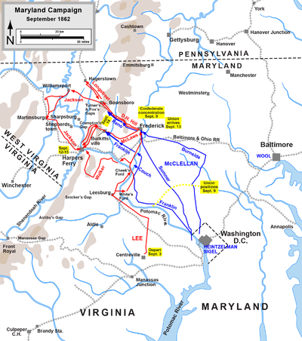

Slide 28
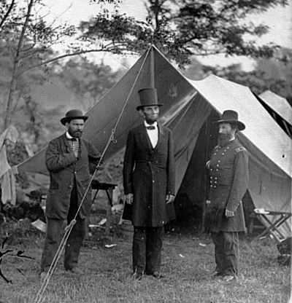
Battle of Antietam (Sharpsburg)
Emancipation Proclamation effects – major reason the Union won the Civil War
Freed ONLY slaves in the REBELLING STATES!!
Made the war about MORALITY!!
Provided foundation for Massachusetts forming the 54th Regiment – ALL BLACK soldiers – 1st time
Eventually caused both Britain and France to resist aiding the South because of slavery

Slide 29
Emancipation Proclamation
Signed by Lincoln on 12/31/1862
Freed only the slaves in the rebelling states (cotton states / Confederacy)
Bold political move that changed the course of the war on both sides – war became about FREEING THE SLAVES instead of PRESERVING THE UNION
Caused Britain and France to not recognize Southern independence
On that same day, December 31, 1862, Lincoln also signed a contract with Bernard Kock, an ambitious and unscrupulous venturer, to use FEDERAL FUNDS to remove some five thousand black men, women, and children from the United States to a small island off the coast of Haiti.
Colonization in Central America

Slide 30
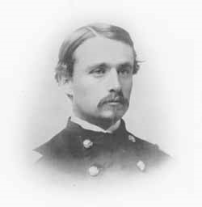
54th Massachusetts Regiment
The Fifty-fourth Massachusetts Volunteer Infantry Regiment was the first military unit consisting of black soldiers to be raised in the North during the Civil War. Prior to 1863, no concerted effort was made to recruit black troops as Union soldiers.
Confederate proclamation of December 23, 1862, effectively put both African-American enlisted men and white officers under a death sentence if captured
As part of the Port Royal Experiment, the regiment participated in a raid of Darien, GA in which the town was burned and innocent townspeople were killed. Shaw strongly objected!
Cpt. Robert Gould Shaw
Port Royal Experiment – Union program that gave plantation land to former slaves as SC was liberated. The info that former slaves and black soldiers were contributing to Union effort was detrimental to the Confederate mindset ~ added further insult to the Union defeating the Confederate Army in the South

Slide 32
First SC Volunteer Regiment
Actually the very first all – black unit formed by David Hunter to take over the South Carolina Sea Islands
Part of the Port Royal Experiment – as various towns and locations were “liberated” the Union Army collected and mustered those men into Volunteer units – did not see much fighting
Used as a political and sociological force in the South to aid in surrender – HOW?

Slide 33
MILITIA ACT OF 1862
Called for the drafting of 300,000 troops including “Colored Troops” in the Union Army
Praised by many abolitionists activists as a first step toward equality, it stipulated that the black recruits could be soldiers or manual laborers
Black soldiers pay was still less than white soldiers
$10 monthly with a $3 clothing deduction
Whites -- $13 monthly pay

Slide 34
Congress
Abolishes SLAVERY in Washington D.C. and the territories of the United States
Complete abolition will not come until the passage of the Thirteenth Amendment to the Constitution
Ample precedent

Slide 35
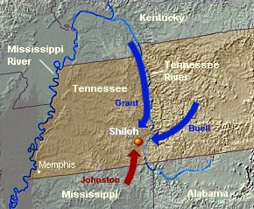
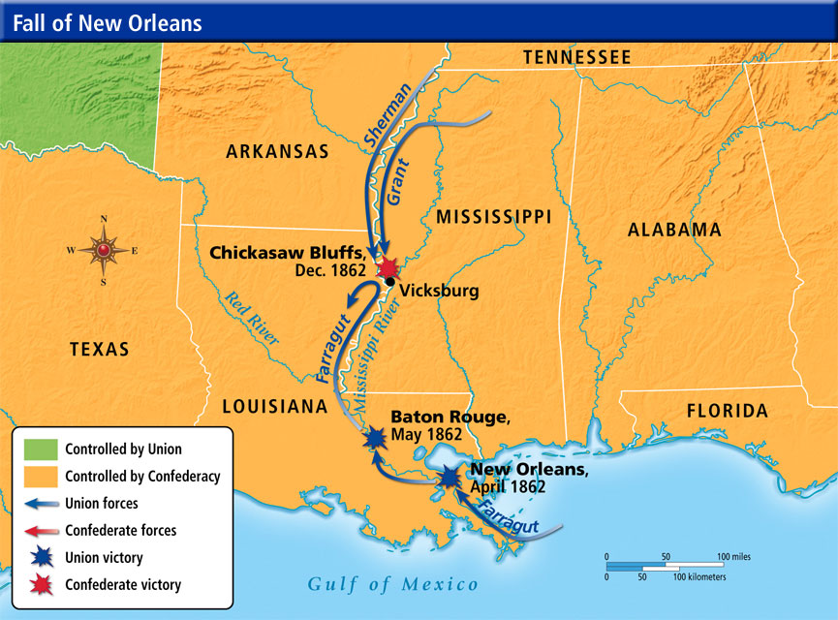
Civil War in the Western Theater - 1862
Battle of Shiloh
Control of New Orleans

Slide 36
Battle of Shiloh (Pittsburg Landing), TN April 1862
Union Army (Army of THE Tennessee (Grant) and Army of THE Ohio
Commanders – Ulysses S. Grant / Don Carlos Buell
Strength – 63,000
GOAL – capture Chattanooga then advance to Corinth, MS for a rail center
RESULT – VICTORY
Significance --
Confederate Army (Army of Mississippi)
Commanders – Albert Sidney Johnston / P.G.T. Beauregard
Strength – 40,000
Surprise attacked the Union -

Slide 37
“Lost Opportunity” of the Confederacy
Confederacy was in control of the field after 1st and 2nd days – Had been EAGER to get back lost Southern forts and territory (Henry and Donelson)
1 – Johnson halted a Confederate attack at 9:30 am to divert soldiers to right flank (didn’t need to do this because it was not under attack by a large Union force)
He then had to attack the “Hornet’s Nest” in the center of Union lines (HEAVILY DEFENDED because of the right flank attack delay
Major setback – A.S. Johnston dead (highest ranking officer to die in the war) maybe from friendly fire as he attacked the Union Left
P.G.T. Beauregard halts the Confederate attack at dusk of 2nd day (for resting purposes) – allowed the Union to move soldiers to front
Confederate leaders didn’t inspect the Union front lines on last morning of battle (Beauregard) – underestimated Union force (they had moved an additional 20,000 men to front during the night)
Union seized victory under U.S. Grant the following day
OPENS THE DOOR ---

Slide 39
Conscription – Military Draft Act - 1863
Also known as the Enrollment Act
Enrollment of every male citizen and those immigrants who had filed for citizenship between ages twenty and forty-five.
Federal agents established a quota of new troops due from each congressional district
Resulted in the Draft Riots in NYC in July
Working class men were angry at being forced into the military
Mostly Irish – didn’t want to compete with free blacks for jobs – angry at wealthy whites who could afford the $300 stipend to not go to war
TURNED INTO A RACE RIOT
120 dead / blacks leave Manhattan for Brooklyn
45,000 actual men went on active duty out of the 750,000 that were selected for the draft nationwide

Slide 40
Battle of Chancellorsville, VA – April – May 1863
Turning point battle – why? Death of Thomas J. “Stonewall” Jackson (Lee’s “RIGHT ARM”)
Union General (Army of the Potomac) – “Fightin’ Joe” Hooker – replaced Burnside (who had replaced McClellan) Hooker is replaced by MEADE
Confederate General (Robert E. Lee) – Lee split his troops (only had 60,000 anyway) vs. the Union (133,000)
Lee deployed Jackson’s troops around the Union flank and he routed the Union – however on a reconnaissance mission that night, Jackson fell victim to friendly fire who mistook his group for Union soldiers

Slide 41
Lee’s “Perfect Battle”
Lee, despite being outnumbered by a ratio of over two to one, won arguably his greatest victory of the war
A terrible price was paid for it
With only 60,000 men engaged, he suffered 13,303 casualties (1,665 killed, 9,081 wounded, 2,018 missing), losing some 22% of his force in the campaign—men that the Confederacy, with its limited manpower, could not replace.
Confederacy also lost Lee’s most aggressive field commander, Stonewall Jackson
Union General Hooker – had at least an 80% chance of winning was humiliated – eventually replaced by U.S. Grant

Slide 42
JULY 1863
Vicksburg, Mississippi
Turning Point Battle
Why?? Grant was the Union leader of the Army in the West
It was effective in quieting the Northerners who wanted peace
After this victory he was elevated to command of the Army of the Potomac to do battle with ROBERT E. LEE
Gave Union control of Miss. River / effectively cut off TX, AR, LA from Confederacy
Grant abandoned his usual policy of Unconditional Surrender – regretted this
Residents forced the Confederacy to surrender / eating dogs, cats, rats, etc.

Slide 43
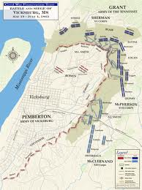
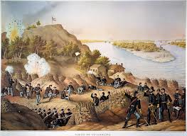
Vicksburg, MS (Siege)

Slide 44
July 1863
Gettysburg, Pennsylvania
According to text – THE MAJOR TURNING POINT BATTLE OF THE WAR
Why did Lee go North? - POLITICAL ? Shoes?
Marked the high-water point of the Confederacy
UNION – MEADE vs CONFEDERACY -- LEE
2nd battle in the North
Confederate offensive – Roads led the Confederates to this chance meeting / NOT supplies (SHOE MYTH)- Henry Heth’s account 10 weeks after the battle mentioned shoes ( actually there were NO shoe factories or warehouses in G-burg.
Bitter defeat at the hands of the Union Army – WHY?
Site of Pickett’s Charge – 12,000 Confederates charge up Cemetery Ridge / badly beaten

Slide 45
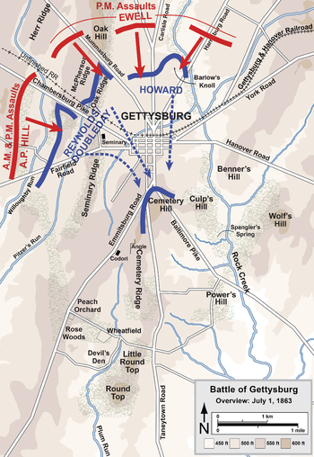
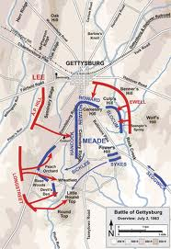
Gettysburg, PA

Slide 46
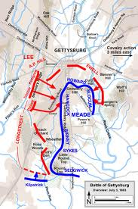
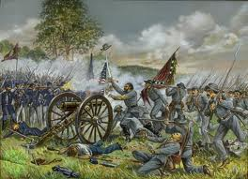
Gettysburg – DAY 3

Slide 47
1864 Change in Union Strategy
TOTAL WAR – Total Annihilation and Destruction / taking the war to the civilians / destroying property / and CAPTURING ROBERT E. LEE and arming black soldiers (brilliant political move)
Major Players –
U.S. GRANT – Commander of the Army of the Potomac
WILLIAM TECUMSEH SHERMAN – Commander of the Military Division of Mississippi (including the Army of the Cumberland, Tennessee and Ohio) – “scorched-earth” policy
PHILIP SHERIDAN – General of the U.S. Cavalry

Slide 48
Sherman’s March to the Sea
Sherman’s SCORCHED EARTH POLICY from Chattanooga to Savannah
60 MILE WIDE PATH OF DESTRUCTION
Sherman’s Neckties
Burned Atlanta
Spared Savannah
Prediction in 1861 ------
“You people of the South don't know what you are doing. This country will be drenched in blood, and God only knows how it will end. It is all folly, madness, a crime against civilization! You people speak so lightly of war; you don't know what you're talking about. War is a terrible thing! You mistake, too, the people of the North. They are a peaceable people but an earnest people, and they will fight, too. They are not going to let this country be destroyed without a mighty effort to save it... Besides, where are your men and appliances of war to contend against them? The North can make a steam engine, locomotive, or railway car; hardly a yard of cloth or pair of shoes can you make. You are rushing into war with one of the most powerful, ingeniously mechanical, and determined people on Earth—right at your doors. You are bound to fail. Only in your spirit and determination are you prepared for war. In all else you are totally unprepared, with a bad cause to start with. At first you will make headway, but as your limited resources begin to fail, shut out from the markets of Europe as you will be, your cause will begin to wane. If your people will but stop and think, they must see in the end that you will surely fail.”

Slide 49
Sherman’s March to the Sea
Marched with 62,000 soldiers to Savannah
Caused over $100 million damages to government buildings and private structures
“made Georgia howl” – captured Atlanta (helped Lincoln get re-election in 1864)
Burned crops, killed livestock, consumed supplies, looted, pillaged, stole anything they could from civilians
Offered President Lincoln the city of Savannah as a Christmas present
Destroyed the Confederates physical and psychological ability to wage war

Slide 50
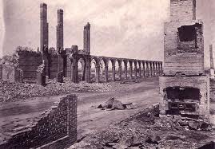
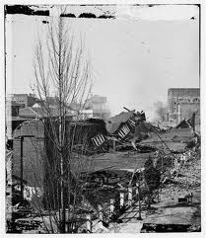
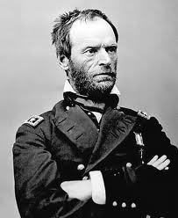
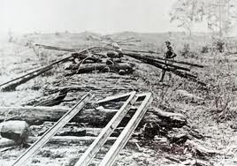
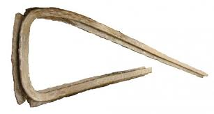

Slide 51
Special Field Orders #15
Sherman set aside 80,000 acres in South Carolina, Georgia and Florida for the purpose of resettling black slaves once the war was over
“40 acres and a mule” idea that is eventually taken up by the Freedmen’s Bureau
Organization established by the US government in 1865 as the Bureau of Refugees, Freedmen, and Abandoned Lands – headed up by General O.O. Howard
Never realized – imminent domain
ANDREW JOHNSON rescinded the orders LATER In 1865 – and returned the land to its rightful owners

Slide 52
Fort Pillow Massacre – 1864

Slide 53
Fort Pillow
Tennessee – probable causes (use of black soldiers and the Emancipation Proclamation) – angered many proud Southerners
General Nathan Bedford Forrest – eventual founder of the KKK
600 Union soldiers defended the fort – 300 Black and 300 white roughly –
As the black soldiers surrendered they were indiscriminately shot and bayoneted by the Rebel forces under Forrest (he claimed he did not give the orders to do so – disputed and challenged but cannot be proven true or false)
The Confederate refusal to treat the soldiers as traditional prisoners of war infuriated the Union and caused them to refuse to participate in future prisoner exchanges
ALSO caused Congress to speed up plans to end the WAR

Slide 54
Grant in Virginia vs. Robert E. Lee
THE WILDERNESS CAMPAIGN -- 1864
Grant was a proponent of “Total War” as well
Grant – 120,000 vs. Lee –65,000 soldiers (Grant and the Union routinely outnumbered the Confederates as much as 2-1)
BATTLE OF THE WILDERNESS – VA —
http://www.vahistorical.org/lg/maps_wilderness.htm
Significance of the battle –
Though the battle was technically a draw –
1st time that the Union Army headed SOUTH after the battle –
Previously they had always retreated back to the North

Slide 55
Overland Campaign
BATTLE of COLD HARBOR, VA –1864
Grant ordered a frontal assault at the center of a 7 mile long Confederate line
Grant had troops write their identification (name, address, etc) on paper that was pinned to their backs
Early form of dogtags / soldiers KNEW they were facing certain death
7000 Union soldiers killed
Confederates had set up the line of defense to keep the Union troops away from the Richmond capital
Grant swung wide around Lee’s flank again
Grant regretted this battle – senseless loss of lives

Slide 56
1864 – 1865 – the final chapter
BATTLE of PETERSBURG, VA
UNION SIEGE of Petersburg – lasted for 10 months
Union attempted to tunnel underground
Finally forced Lee to flee Petersburg and abandon the capital of the Confederacy at Richmond
The road to Richmond opened and Grant captured the capital city in April of 1865
Lee escaped to Appomattox Court House, VA having lost 35,000 men to Grant’s 65,000 soldiers during the siege

Slide 57
1865 – Lee’s surrender to Grant
GRANT had earned a reputation as Unconditional Surrender Grant – what does this mean?
Occurred at Appomattox Court House, VA
Grant had Lee surrounded; sent him a telegram by courier explaining that any further bloodshed would be Lee’s fault
Lee rode his horse, Traveler, up the lane to the salute of all the Union soldiers
Confederates were forced to give up their rifles; officers could keep their sidearms and horses / Union treated the Confederates to a hot meal and they were released to go home.

Slide 58
Role of Blacks in the Civil War -- South
65,000 black soldiers were enlisted in the Confederate Army
Many were cooks, musicians, laborers, servants, etc. However 13,000 black soldiers were actively involved in combat, manning artillery and in the ranks of the enlisted privates. One black officer, James Washington, existed.
Confederate government forbid black soldiers from carrying arms but officers in the field tended to disobey government’s orders.
Free black musicians, cooks, soldiers and teamsters earned the same pay as white confederate privates. This was not the case in the Union army where blacks did not receive equal pay. At the Confederate Buffalo Forge in Rockbridge County, Virginia, skilled black workers "earned on average three times the wages of white Confederate soldiers and more than most Confederate army officers ($350- $600 a year).
WOMEN served as spies, cooks, laundresses – could not officially join the military

Slide 59
Role of Blacks in the Civil War -- North
179,000 black men served in the Union Army -- Nearly 40,000 black soldiers died over the course of the war—30,000 of infection or disease.
There were nearly 80 black commissioned officers -- perils of war faced by all Civil War soldiers, black soldiers faced additional problems stemming from racial prejudice. Racial discrimination was prevalent even in the Union, and discriminatory practices permeated the U.S. military.
Segregated units were formed with black enlisted men and typically commanded by white officers and black noncommissioned officers. The 54th Massachusetts was commanded by Robert Shaw.
Black soldiers were initially paid $10 per month from which $3 was automatically deducted for clothing, resulting in a net pay of $7. In contrast, white soldiers received $13 per month from which no clothing allowance was drawn.

Slide 60
By the end of the Civil War, roughly 179,000 black men (10% of the Union Army) served as soldiers in the U.S. Army and another 19,000 served in the Navy.
Nearly 40,000 black soldiers died over the course of the war—30,000 of infection or disease.
Black soldiers served in artillery and infantry and performed all noncombat support functions that sustain an army, as well.
Black carpenters, chaplains, cooks, guards, laborers, nurses, scouts, spies, steamboat pilots, surgeons, and teamsters also contributed to the war cause.
There were nearly 80 black commissioned officers.
Black women, who could not formally join the Army, nonetheless served as nurses, spies, and scouts, the most famous being Harriet Tubman, who scouted for the 2d South Carolina Volunteers.

Slide 61
John Wilkes Booth was a southern man Born of an actor in Maryland Bound for fortune on a gas-lit stage Bound to die at a tender age
Washington to Baltimore He played the bills and he slept with whores And he burned inside with a hatred deep For the man who caused the south to weep
Young Abe Lincoln wasn't young no more Tired old man when he won the war And he dreamed at night of his death by the hands Of the bitter world and a faceless man
And he saw his body in a ghastly dream Draped in black while his widow screamed Two silver dollars on his eyelids lay Abraham Lincoln has died today
And they said there were five and they said there were ten Some say there was never more than just one man Who would smile to see Mr. Lincoln dead In the name of God and Dixie, in the name of God and Dixie Land
John Wilkes Booth and his band of men They'd failed before but would not again When Good Friday dawned with a fickle sun Then Booth declared the day had come
And the word was passed and the guns were brought Down to Mary Surratt's boarding house Sealed in a note, Booth named just four But would the gallows sway with many more?
And they said there were five and they said there were ten Some say there was never more than just one man Who would smile to see Mr. Lincoln dead In the name of God and Dixie, in the name of God and Dixie Land
John Wilkes Booth went to his grave With a bullet in his neck and a broken leg A patriot and his fantasy Of redemption, grace and bravery And those who were hanged and those who spent Their lives behind a jailer's fence Only Booth could have proved them free Of the taint of the conspiracy For they said there were five and they said there were ten Some said there was never more than just one man Who would smile to see Mr. Lincoln dead In the name of God and Dixie, in the name of God and Dixie Land In the name of God and Dixie, in the name of God and Dixie Land
Songwriters Carpenter, Mary Chapin

Slide 62
Lincoln’s Assassination – 4/15/1865
Lincoln, only days before, had sat in Jefferson Davis’ presidential chair in his Richmond office
Allegedly part of a large conspiracy to assassinate Vice President Andrew Johnson, Asst. Secretary of State William Seward and U.S. Grant
Occurred at Ford’s Theatre in Washington, D.C. during the play “Our American Cousin”.
Assassin was John Wilkes Booth, an actor. Booth was shot and killed by a soldier, Boston Corbett, as he exited the barn where he had been surrounded.
Conspirators who were also tried included Mary Surratt, George Atzerodt, Lewis Powell, Dr. Samuel Mudd, Samuel Arnold, Edmund Spangler, David Herold, and Michael O’Laughlen
4 were hanged – Surratt (first woman ever executed in America), Powell, Atzerodt, Herold – the rest were all found guilty

Slide 63
The “one” who got away…..
John Surratt (Mary’s son) escaped overseas and upon his return he was tried in a CIVILIAN COURT for his role in the murder conspiracy of Lincoln.
Statute of limitations had expired on kidnapping – he was released on $25,000 bail.

Slide 64
Execution of Lincoln Conspirators

Slide 65
Aftermath
Lincoln’s assassination proved to be disastrous for the South – “with malice toward none, with charity for all”
Lincoln wanted to welcome the South back into the Union with open arms.
Upon his assassination, the Radical Republicans gained the power to implement their Reconstruction plan, which was aimed at PUNISHING THE SOUTH!!

