Slide 1
World
War
II
By: Shannon Slaughter
St. Clair County High School

Slide 2
The Road
to
War:
1919-1939

Slide 3
WORLD WAR II -1939-1945
Treaty of Versailles- ended WWI – treaty helped fan the flames that started WWII- the “war-guilt” clause
Germany – lost land
Germany- pay reparations- $33 million
Apologize- Germany
No military – Germany
Imperialism / Nationalism / Militarism

Slide 4
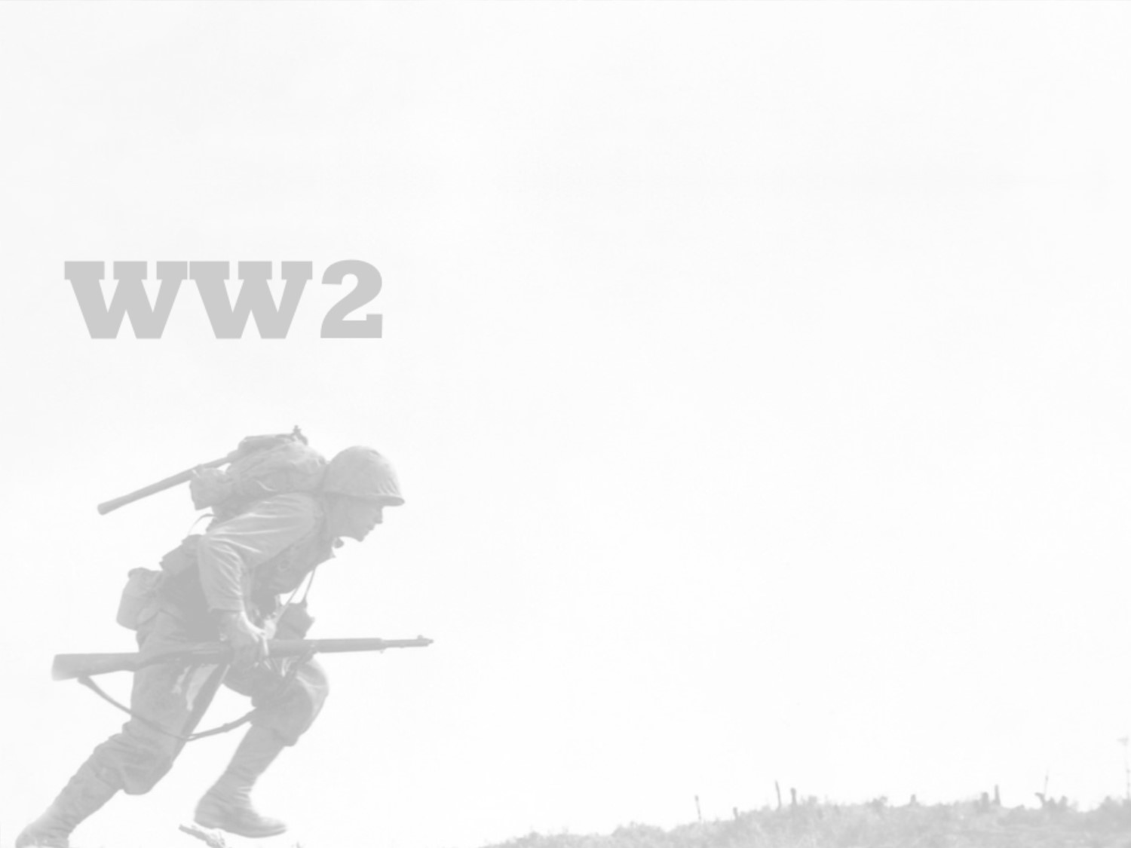
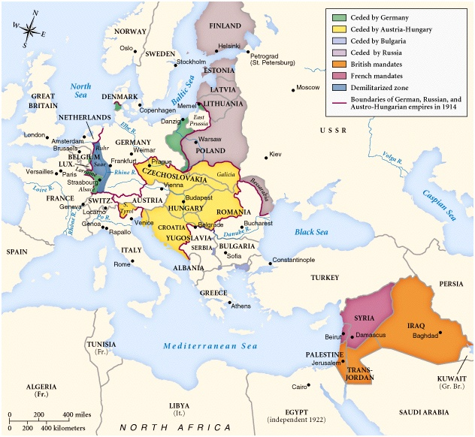
The Versailles Treaty - 1919

Slide 5
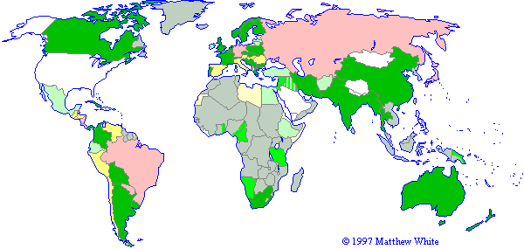
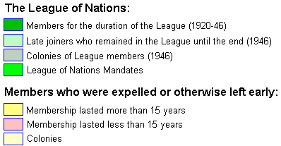
A Weak League of Nations

Slide 6
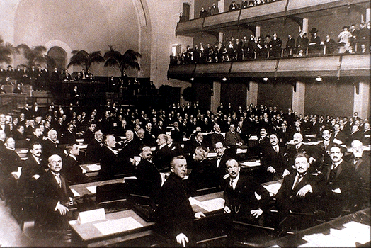
The Ineffectiveness of the League of Nations
No control of major conflicts.
No progress in disarmament.
No effective military force.

Slide 7
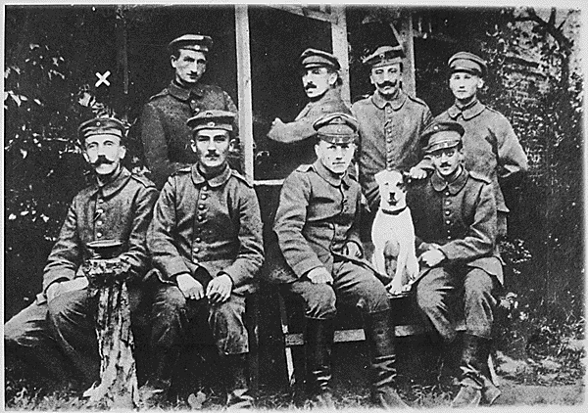
The “Stab-In-The-Back” Theory - MYTH
Leads to RISE of NAZISM – PROPAGANDA
Hitler
German soldiers are dissatisfied / feel betrayed by the German leaders who surrendered in WWI.

Slide 8
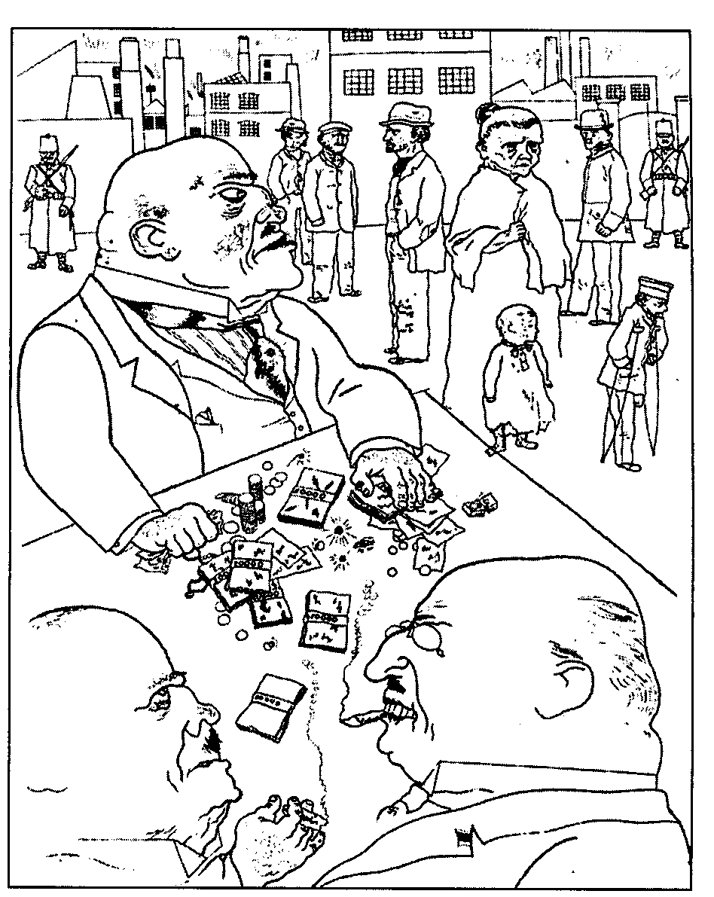
Decadence of the Weimar Republic
Germany became a center of intellectual thought at its universities, and most notably social and political theory (especially Marxism)
Leftist culture with a focus on the arts – many conservatives longed for change

Slide 9
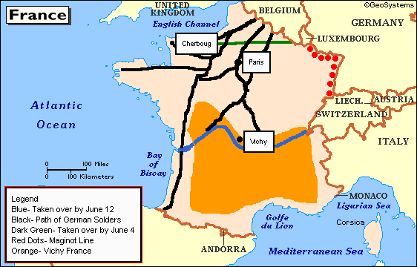
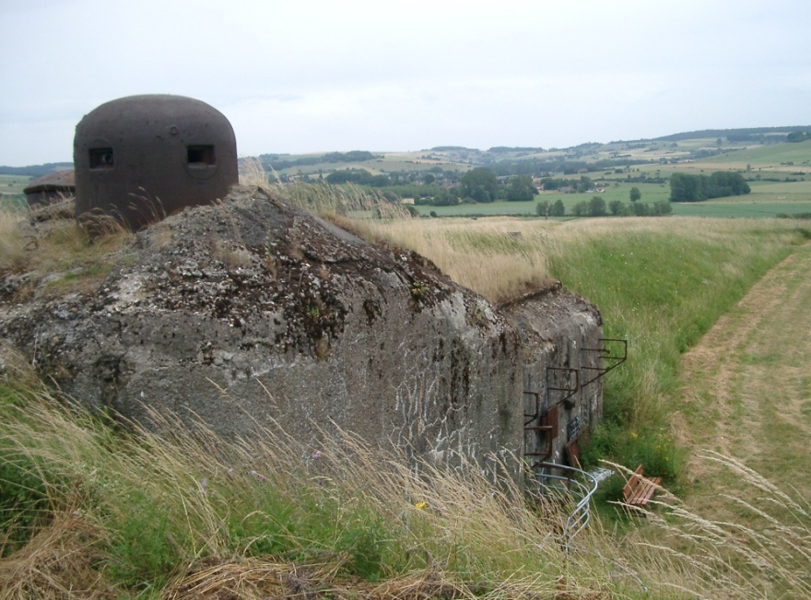
France – False Sense of Security?
The Maginot
Line – designed to allow France to mobilize their army / didn’t work / Germany went around it

Slide 10
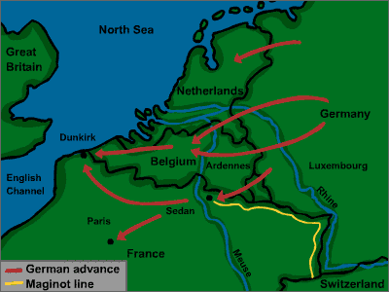
France – False Sense of Security?

Slide 11
International Agreements
Locarno Pact – 1925
  France, Germany, Great Britain,
  Italy
    Guarantee existing frontiers
    Establish DMZ 30 miles deep on East
    bank of Rhine River
    Refrain from aggression against each
    other
Kellogg-Briand Pact – 1928
  Makes war illegal as a tool of
  diplomacy
    No enforcement provisions

Slide 12
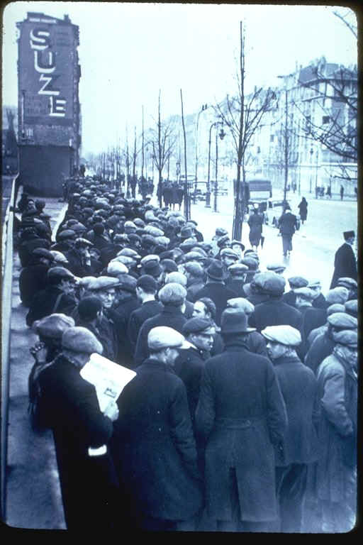
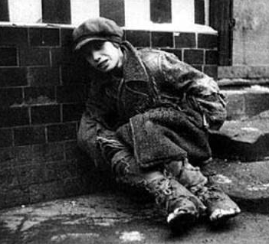
The Great Depression

Slide 13
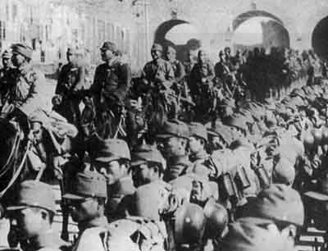
The Manchurian Crisis, 1931

Slide 14
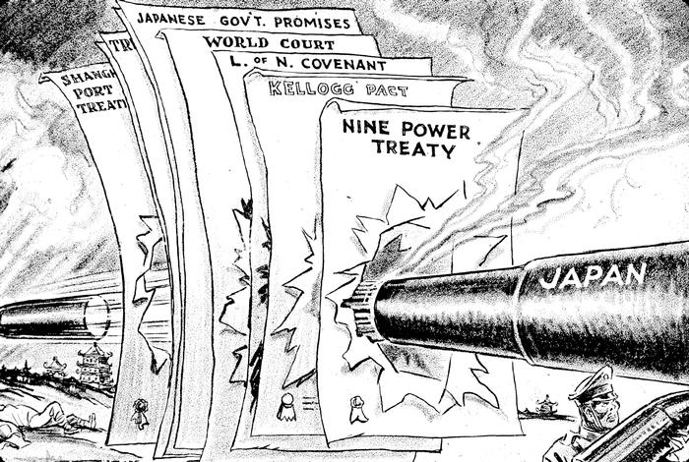
Japan Invades Manchuria, 1931

Slide 15
Fascism & Totalitarianism
Fascism – Italy – BENITO MUSSOLINI
Nation is more important than the individual
Offers full employment and social security
Totalitarianism – Germany HITLER / Japan - HIROHITO
Nation is dominated by singular organization (party) and controls the country through dissemination of propaganda / regulation of free speech / official ideology “Mein Kampff”
NO limits to governmental authority

Slide 16
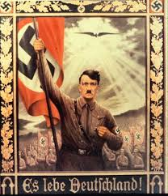
“LONG LIVE GERMANY”

Slide 17
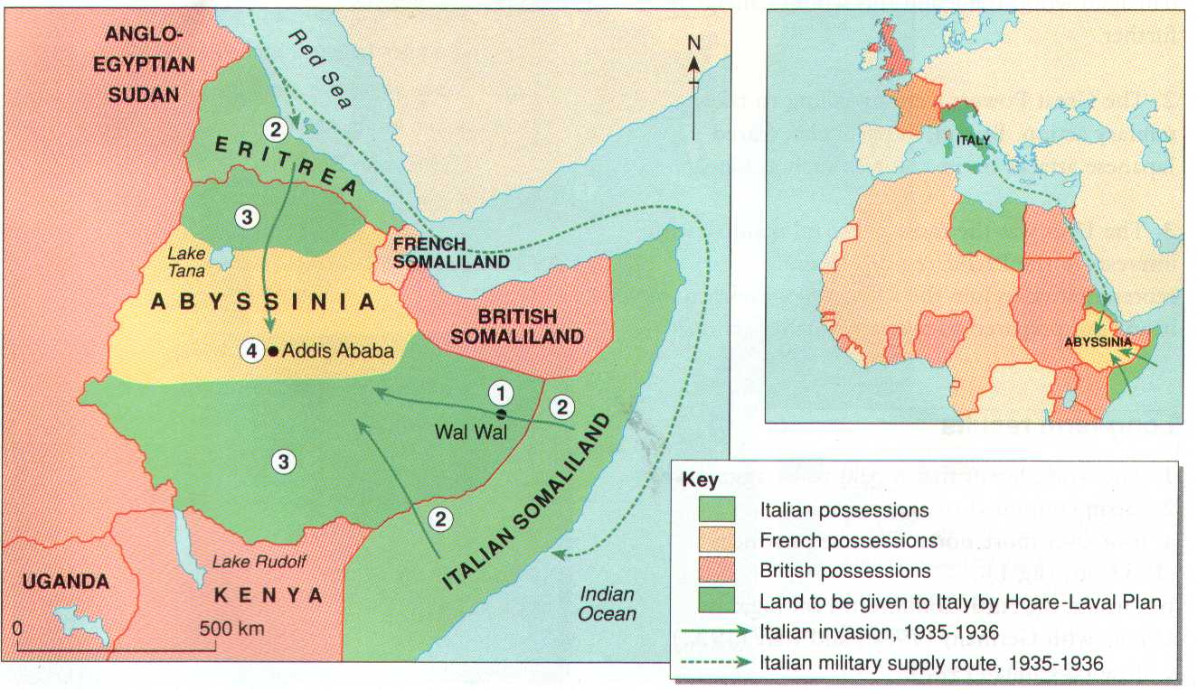
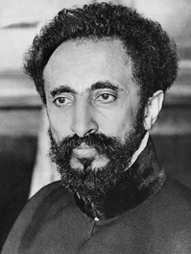
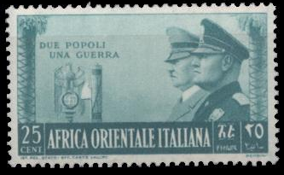
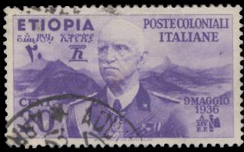
Italy Attacks Ethiopia, 1935
Emperor Haile Selassie

Slide 18
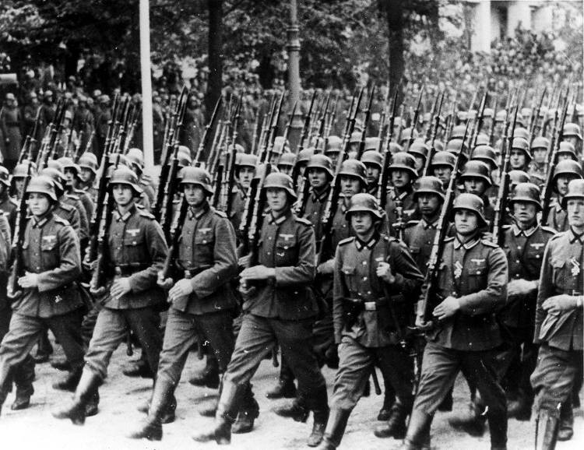
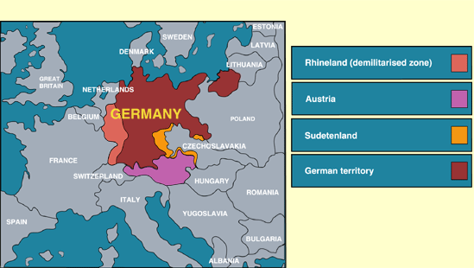
Germany Invades the Rhineland
March 7, 1936

Slide 19
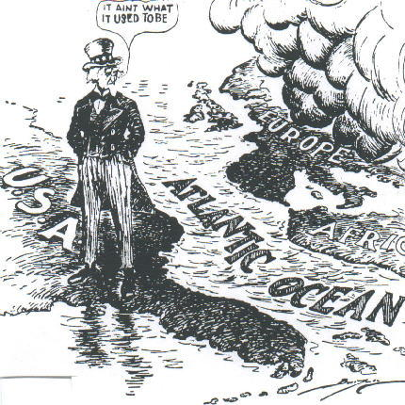
U. S. Neutrality Acts:
1934, 1935, 1937, 1939

Slide 20
U.S. NEUTRALITY in 1930s
based on the widespread disillusionment with World War I in the early 1930s and the belief that the United States had been drawn into the war through loans and trade with the Allies

Slide 21
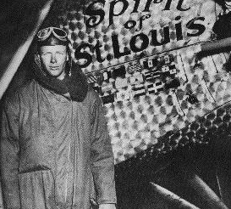
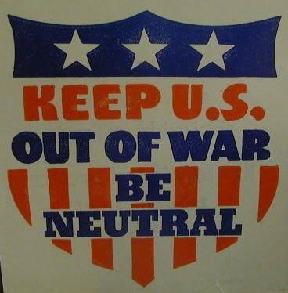
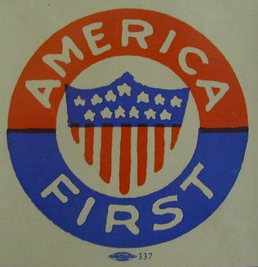
America-First Committee
Charles Lindbergh
Largest domestic pressure group against the American entry into World War II.

Slide 22
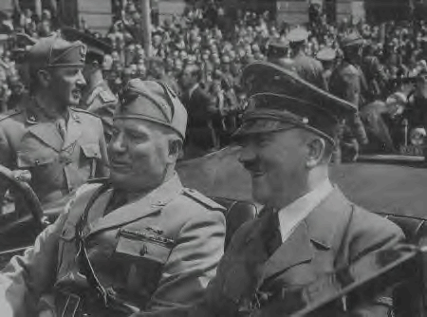
Rome-Berlin Axis, 1936
Informal link - fascist Germany and Italy
The “Pact of Steel”

Slide 23
The Spanish Civil War:
1936 – 1939 – NATIONALISTS WIN
The
National
Front
[Nationalists]
The
Popular
Front
[Republicans]
Carlists [ultra-Catholic
monarchists].
Catholic Church.
Falange [fascist] Party.
Monarchists.
Anarcho-Syndicalists.
Basques.
Catalans.
Communists.
Marxists.
Republicans.
Socialists.

Slide 24
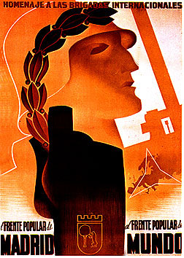
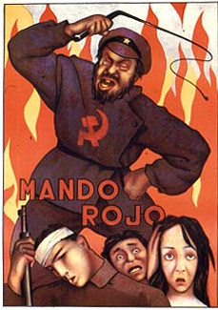
The Spanish Civil War:
1936 - 1939

Slide 25
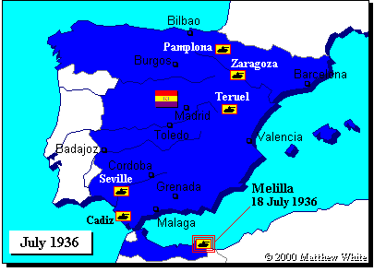
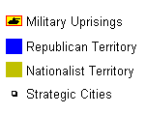
The Spanish Civil War

Slide 26
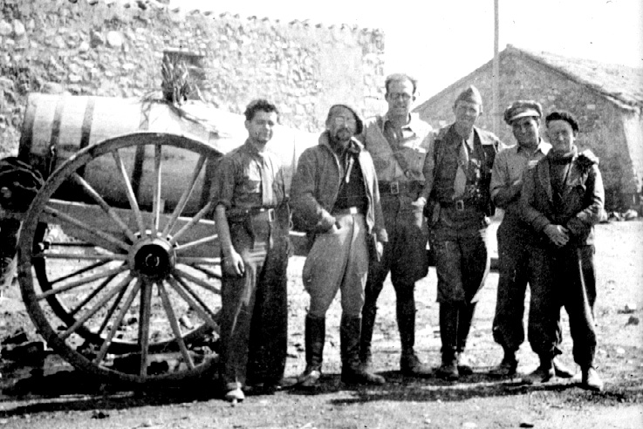
The Spanish Civil War: 1936 - 1939
The American “Lincoln Brigade”

Slide 27
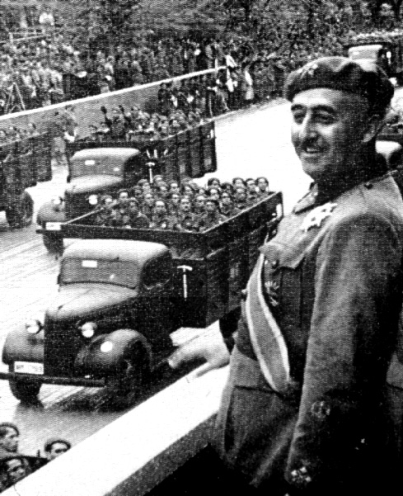
The Spanish Civil War: 1936 - 1939
Francisco Franco

Slide 28
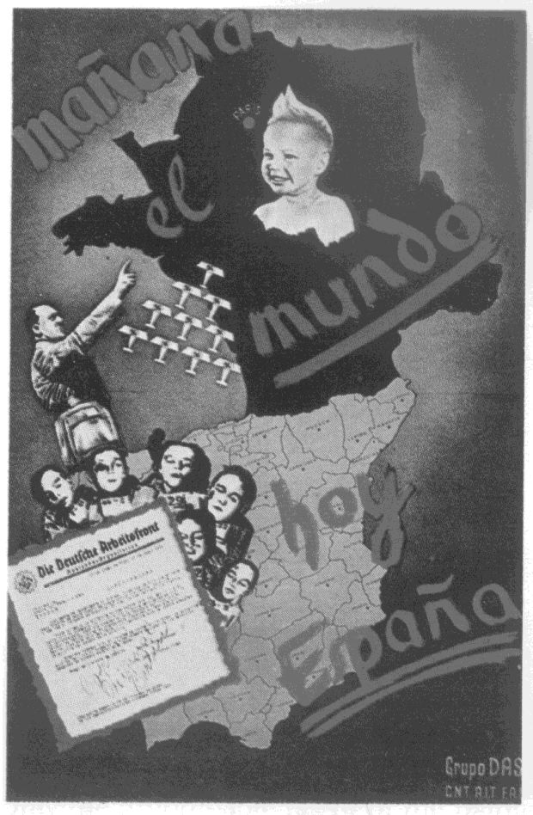
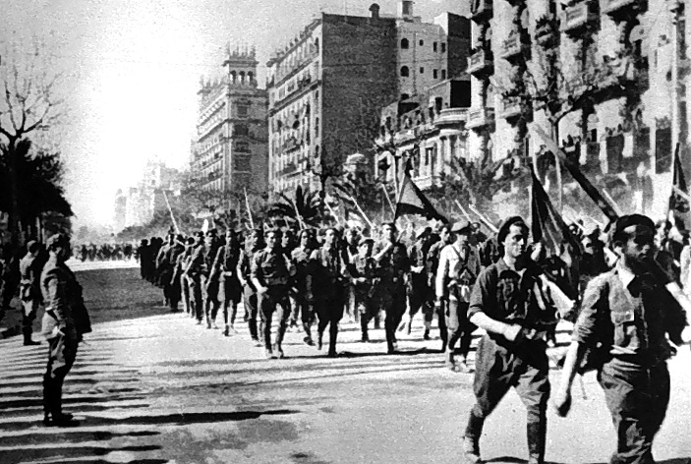
The Spanish Civil War:
A Dress Rehearsal for WW II?
Italian troops in Madrid

Slide 29
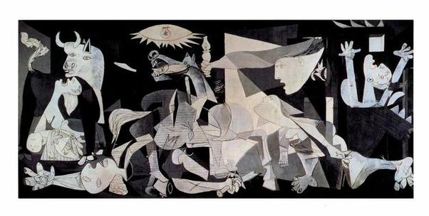
“Guernica” by Pablo Picasso
One of the first ever air raids of a defenseless civilian population by a modern air force

Slide 30
Nationalist support
Germany - sent soldiers (16,000), ammunition and weapons AND also used the Spanish Civil War to test new weaponry – bombed Guernica, Spain
Italy – Mussolini was persuaded by Hitler to get involved in the war as well --machine guns, artillery, aircraft, tankettes and 50,000 soldiers

Slide 31
Republican support
The Soviet Union (Russia)- USSR supplied weapons, tanks, aircraft, etc. covertly to the Republicans
France and Great Britain aided the Republican cause as well.

Slide 32
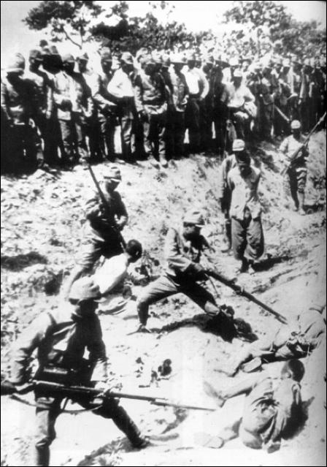
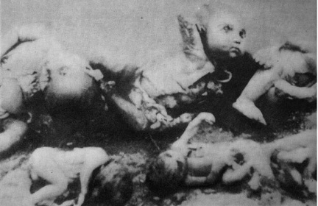
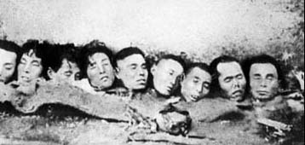
The Japanese Invasion
of China, 1937
Rape of Nanjing – 200-300,000 died in capital city – brutal gang raping of Chinese women

Slide 33
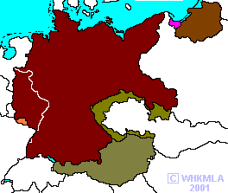
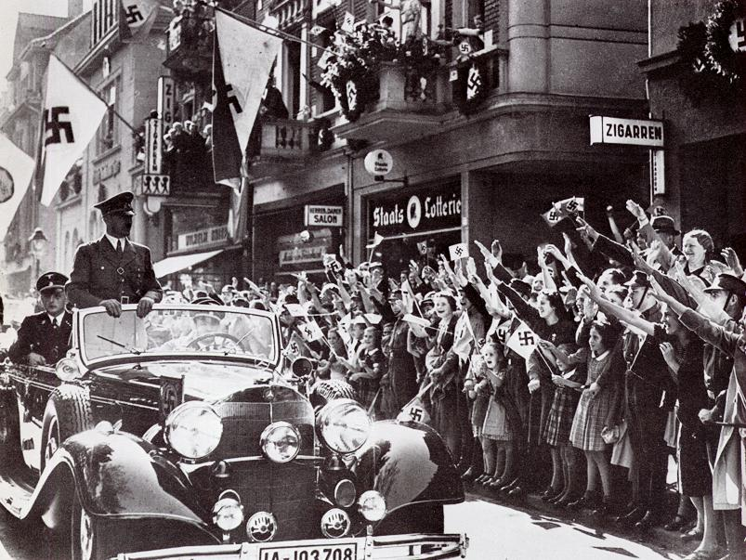
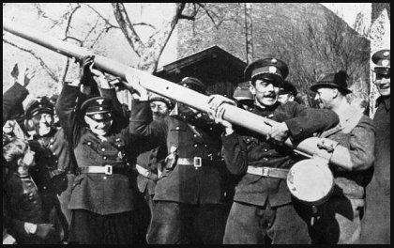
The Austrian Anschluss, 1938

Slide 34
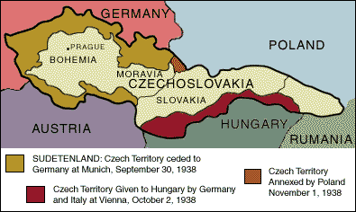
The “Problem” of the
Sudetenland

Slide 35
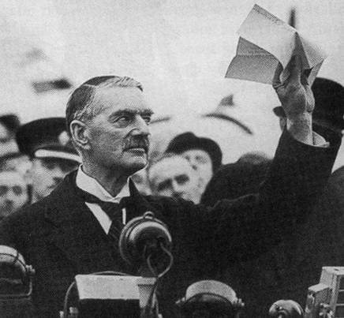
Appeasement: The Munich Agreement, 1938
British Prime Minister Neville Chamberlain
Now we have “peace in our time!” Herr Hitler is a man we can do business with.

Slide 36
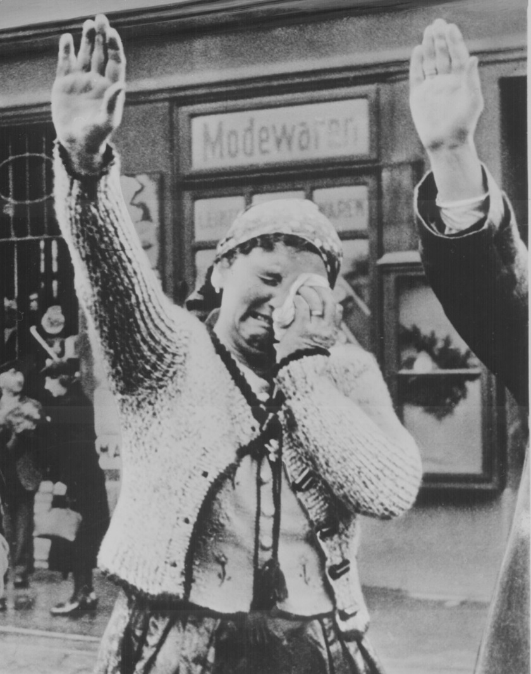
Czechoslovakia Becomes Part of the Third Reich: 1939

Slide 37
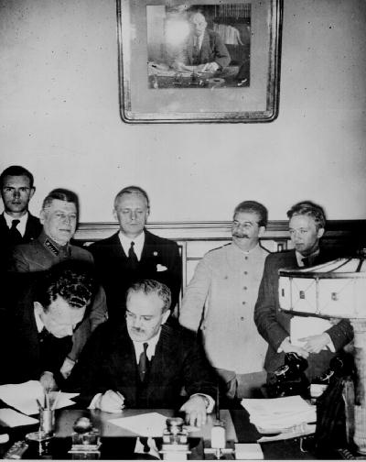
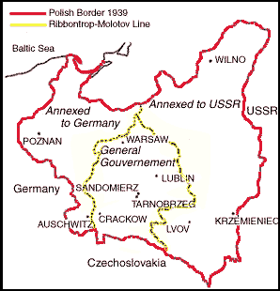
The Nazi-Soviet
Non-Aggression Pact, 1939
Foreign Ministers
von Ribbentrop & Molotov

Slide 38
The
War
Begins!

Slide 39
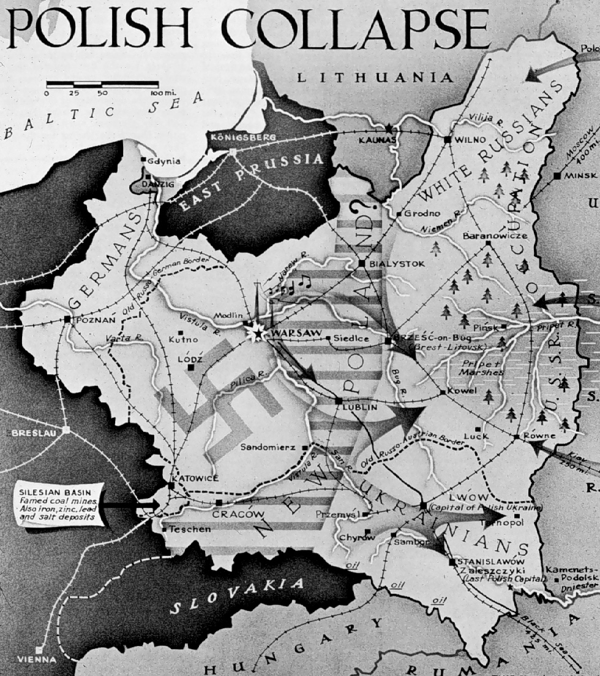
Poland Attacked: Sept. 1, 1939
Blitzkrieg [“Lightning War”]

Slide 40
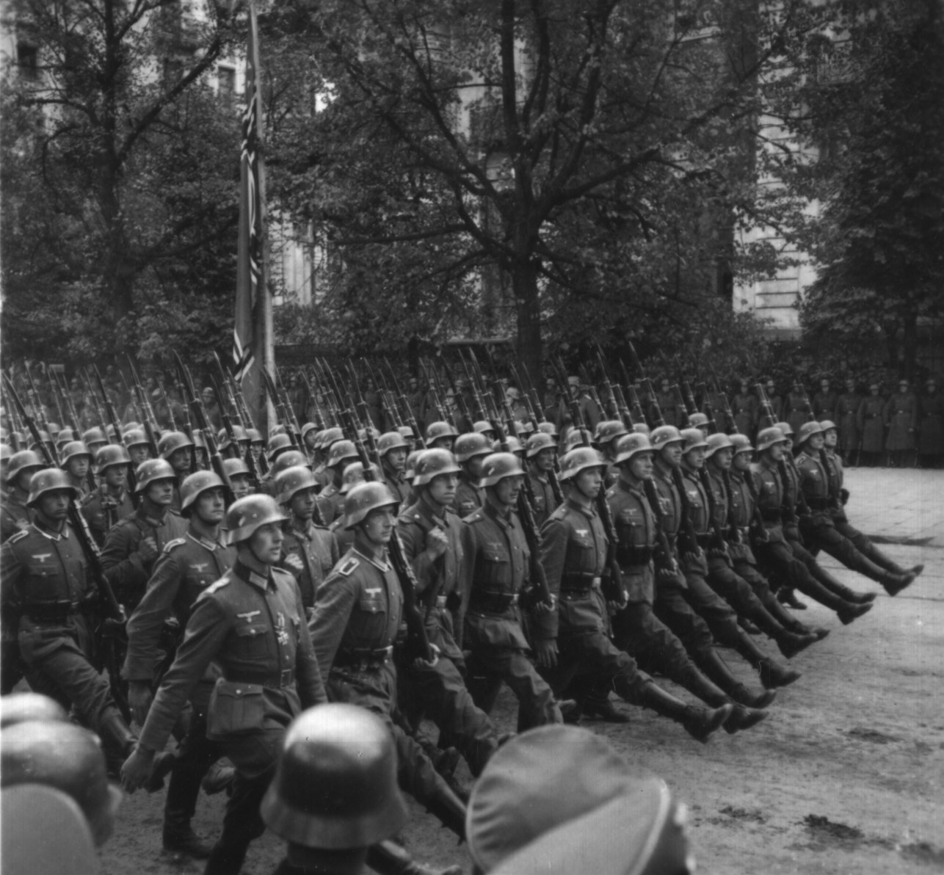
German Troops March into Warsaw

Slide 41
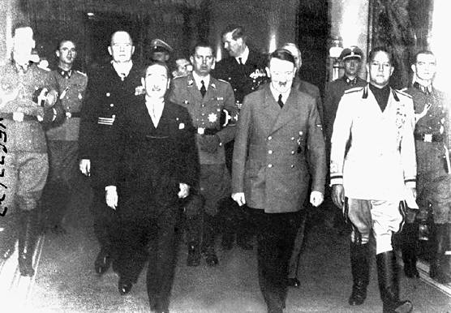
Rome-Berlin-Tokyo Axis, 1940
The Tripartite Pact originally had been the Anti-Comintern Pact between Japan and Germany because of the USSR

Slide 42
The European
& North African
Theaters

Slide 43
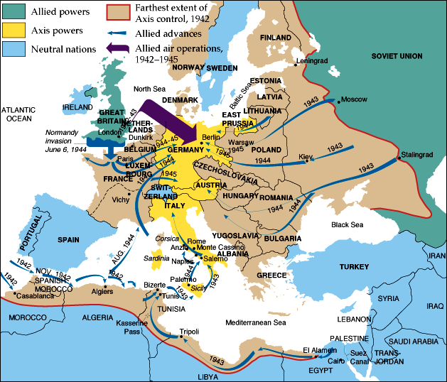
European Theater of Operations

Slide 44

The “Phoney War”
For the first 8 months after Germany’s attack of Poland this refers to the lack of major military land operations by the Allies on Germany's Western Front.
NO Western power committed to launching a significant land offensive
Referred to as a Sitzkrieg by the British Press

Slide 45
The “Phoney War” ends May 1940
German troops marched into Belgium, the Netherlands and Luxembourg, marking the end of the Phoney War.
In 6 weeks Germany had made it through Belgium and around the Maginot Line into France.
6 weeks later, Germany conquered Paris.

Slide 46

Dunkirk Evacuated
June 4, 1940

Slide 47



France Surrenders
June, 1940

Slide 48


A Divided France
Vichy France – de facto “client state” of Nazi Germany – Free Zone
Phillipe Petain – conspired with NAZIS in France after a distinguished French military career / TREASON / Death sentence / WWI service = life imprisonment

Slide 49



The French Resistance
The Free French
General Charles DeGaulle
The Maquis

Slide 50

Now Britain Is All Alone!
After the fall of France – Britain stood as the last major European superpower - Democracy

Slide 51
U. S. Lend-Lease Act,
1941
Great Britain.........................$31 billion
Soviet Union..........................$11 billion
France..................................$3 billion
China..................................$1.5 billion
Other European......................$500 million
South America.......................$400 million
The amount totaled: $48,601,365,000

Slide 52

Lend-Lease

Slide 53


Battle of Britain:
The “Blitz”

Slide 54


Battle of Britain:
The “Blitz”

Slide 55

The London “Tube”:
Air Raid Shelters during the Blitz

Slide 56



The Royal Air Force

Slide 57

British Prime Minister Winston Churchill

Slide 58


Churchill was moved by the actions of the RAF in defense of London / attack of Berlin

Slide 59

The Atlantic Charter
Roosevelt and Churchill sign treaty of friendship in August 1941.
Solidifies alliance between US and Britain.
Fashioned after Wilson’s 14 Points.
Calls for League of Nations type organization.

Slide 60

Operation Barbarossa:
Hitler’s Biggest Mistake
Stalingrad

Slide 61

Operation Barbarossa:
June 22, 1941
3,000,000 German soldiers.
3,400 tanks.
Hitler estimated the Soviet takeover would last 3-4 months
German soldiers weren’t prepared for winter

Slide 62
American strategy in WW II
Initial American strategy was to focus on Europe – Germany and Italy
Invaded the “soft underbelly” of Europe in N. Africa then Italy
May 1942 America actually began battles against Japan in the Pacific.

Slide 63

Axis Powers in 1942

Slide 64


Battle of Stalingrad: TURNING POINT
Winter of 1942-1943
German Army | Russian Army
1,011,500 men | 1,000,500 men
10,290 artillery guns | 13,541 artillery guns
675 tanks | 894 tanks
1,216 planes | 1,115 planes

Slide 65


The North Africa Campaign:
The Battle of El Alamein, 1942 – TURNING POINT
Gen. Ernst Rommel,
The “Desert Fox”
Gen. Bernard Law
Montgomery
(“Monty”)

Slide 66
El Alamein Significance
ended the Axis threat to Egypt, the Suez Canal and the Middle Eastern and Persian oil fields via North Africa
Revived Allied MORALE

Slide 67

The Italian Campaign
[“Operation Torch”] :
Europe’s “Soft Underbelly”
Allies plan assault on weakest Axis area - North Africa - Nov. 1942-May 1943
George S. Patton leads American troops
Germans trapped in Tunisia - surrender over 275,000 troops.

Slide 68


The Battle for Sicily:
June, 1943
General
George S. Patton

Slide 69

The “Big Three”
Winston Churchill, Franklin Roosevelt, Joseph Stalin

Slide 70
Tehran Conference - 1943
Americans finally committed to launching Operation Overlord – D Day
Soviet Union would declare war against Japan following an Allied victory over Germany

Slide 71
Operation Husky – Allied Invasion of Sicily, Italy
Husky began on the night of 9/10 July 1943, and ended on 17 August.
Husky achieved the goals set out for it by Allied planners
Allies drove Axis air, land and naval forces from the island and the Mediterranean Sea lanes were opened for Allied merchant ships for the first time since 1941.
Benito Mussolini was toppled from power in Italy and the way was opened for the invasion of Italy

Slide 72


George C. Scott
Playing General Patton in the 1968 Movie, “Patton”

Slide 73


The Battle of Monte Casino:
February, 1944

Slide 74



The Allies Liberate Rome:
June 5, 1944

Slide 75

Gen. Eisenhower giving orders -D-Day [“Operation Overlord”] – The MAJOR TURNING POINT

Slide 76

D-Day (June 6, 1944)

Slide 77



Normandy Landing
(June 6, 1944)
German Prisoners
Higgins Landing Crafts

Slide 78



July 20, 1944 Assassination Plot
Major Claus von
Stauffenberg

Slide 79

E-mail this to a friend
July 20, 1944 Assassination Plot – part of Operation Valkyrie
1. Adolf Hitler
2. Field Marshall Wilhelm Keitel
3. Gen Alfred von Jodl
4. Gen Walter Warlimont
5. Franz von Sonnleithner
6. Maj Herbert Buchs
7. Stenographer Heinz Buchholz
8. Lt Gen Hermann Fegelein
9. Col Nikolaus von Below
10. Rear Adm Hans-Erich Voss
11. Otto Gunsche, Hitler's adjutant
12. Gen Walter Scherff (injured)
13. Gen Ernst John von Freyend
14. Capt Heinz Assman (injured)

Slide 80
Conspirators to kill Hitler
Stauffenberg / Olbricht
  Killed on the day of the assassination attempt
  Tried to arrest General Fromm to overthrow the German government
  Planted the briefcase bomb at Hitler’s Lair where many of his high counsel were meeting
  Hitler tightened grip on German government
  High German officials had turned on him because he was fighting “suicidal” war on 2 fronts

Slide 81


The Liberation of Paris:
August 25, 1944
De Gaulle in Triumph!

Slide 82


U. S. Troops in Paris, 1944

Slide 83

French Female Collaborators
Women who were accused of collaborating with the Germans while they occupied France had their head shaven in public, some were lynched, beaten, had swastikas branded on their forehead, etc.
Sexist in nature / some had profited / some had belonged to Resistance organizations / some had developed personal relationships. MOST ALL WERE WOMEN – 20,000 total were MARKED OR BRANDED

Slide 84



The Battle of the Bulge:
Hitler’s Last Offensive
Dec. 16, 1944
to
Jan. 28, 1945

Slide 85

Yalta: February, 1945
FDR wants quick Soviet entry into Pacific war.
FDR & Churchill concede Stalin needs buffer, FDR & Stalin want spheres of influence and a weak Germany.
Churchill wants strong Germany as buffer
against Stalin.
FDR argues
for a ‘United
Nations’.

Slide 86

Mussolini &
His Mistress,
Claretta Petacci
Are Hung in Milan, 1945

Slide 87

US & Russian Soldiers Meet at the Elbe River: April 25, 1945

Slide 88

Horrors of the Holocaust Exposed

Slide 89


Horrors of the Holocaust Exposed
Entrance to Auschwitz:
Work Makes You Free
Crematoria at Majdanek

Slide 90

Horrors of the Holocaust Exposed
Eli Wiesel –
NIGHT
Slave Labor at Buchenwald

Slide 91


Horrors of the Holocaust Exposed
Mass Grave / dead on the ground

Slide 92

Horrors of the Holocaust – Mass graves

Slide 93



Hitler’s “Secret Weapons”:
Too Little, Too Late!
V-1 Rocket:
“Buzz Bomb”
V-2 Rocket
Werner von Braun

Slide 94



Hitler Commits Suicide
April 30, 1945
Cyanide & Pistols
The Führer’s Bunker
Mr. & Mrs. Hitler

Slide 95


V-E Day (May 8, 1945)
General Keitel – authorized to sign the surrender- eventually guilty at Nuremburg - executed

Slide 96

V-E Day (May 8, 1945)

Slide 97



The Code Breakers of WW II
The Japanese “Purple” [naval] Code Machine
Bletchley Park
The German “Enigma” Machine

Slide 98
GUIDING QUESTION
To what extent did the Second World War bring about lasting change in the American society, economy and government?

Slide 99
WAR ON THE HOME FRONT

Slide 100
DIPLOMACY IN THE 1920s: ENGAGEMENT WITHOUT ENTANGLEMENTS
Peace with Germany, 1921
League of Nations - “unofficial observers”
Washington Conference (1922)
  Five-Power Naval Treaty of 1922
  Four-Power Treaty
  Nine-Power Treaty – “Open Door” in China
  Significance: battleships and aircraft carriers only; no enforcement mechanism
Kellogg-Briand Pact (Pact of Paris) (1928) – NO MORE WAR
  Problems: “defensive wars”, no enforcement mechanism
Fordney-McCumber Tariff (1922)
Dawes Plan (1924) – US loans $200 million to Germany to pay off Allies
US Isolationism?

Slide 101
DIPLOMACY IN THE 1930s:
FROM ENGAGEMENT TO ISOLATIONISM
Manchuria (1931) - “Stimson Doctrine” (1932)
  Non-recognition of acquisition of territory by force (against the League of Nations)
Hoover – troops out of Haiti (1932), Nicaragua (1933)
“Good Neighbor Policy”
  1933 – US renounced intervention (Roosevelt Corollary)
  1934 - Marines pulled out of Haiti
  1934 – Cuba released from terms of Platt Amendment
  1938 – Mexico nationalized oil cos.; money settlement instead armed intervention
U.S. recognized the Soviet Union (1933)
World Economic (London) Conference (1933)

Slide 102

FROM ISOLATIONISM TO WAR
Nye Committee (1934) – public opinion?
  committee documented the huge profits that arms factories had made during the war. It found that bankers had pressured Wilson to intervene in the war in order to protect their loans abroad
Neutrality Acts of 1935, 1936 and 1937
German aggression
  1935 – compulsory military service; air force and armored divisions
  Rhineland, 1936
  Austria, 1938 - Anschluss
Munich Conference (Sept 1938)
  appeasement
March 1939 – Germany took remainder of Czechoslovakia
Notes:
Carnes & Garrity, The American Nation 12e

Slide 103

MOBILIZING THE ECONOMY
1. Industrial Production
War Production Board (later: Office of War Mobilization)
  By 1944, war production double that of all Axis powers
  “cost-plus” basis
  Similar to WWI – WIB
Results:
  end of Depression;
  consolidation of U.S. industry
Notes:
Faragher, Out of Many, 3rd Ed.; http://wps.prenhall.com/hss_faragher_outofmany_ap/

Slide 104
Lockheed Martin Aircraft – OPERATION CAMOUFLAGE
In the days following the attack on Pearl Harbor ------
ORDERS – ALL aircraft in the air!!
West – protection against Japanese attack
Inland – prevent strafing bombing runs
Security – patrollers for US citizen confidence
Lockheed Burbank, CA facility -- Col. John F. Ohmer
Ohmer’s mission? Find a way to disguise Lockheed’s plant—now one of the most strategic military facilities in the United States—to look like an ordinary California suburb.

Slide 105



Slide 106



Slide 107
Effects of War Spending
Notes:
Faragher, Out of Many, 3rd Ed.; http://wps.prenhall.com/hss_faragher_outofmany_ap/

Slide 108


MOBILIZING THE ECONOMY
2. Rationing and Price Controls
Office of Price Administration
rationing
Anti-Inflation Act
3. Controlling Labor
”no-strike” pledges
personal income
union membership: major increase
Labor Union Membership, 1920-1960
Ration Card
Notes:
Pojer (ration card); Brinkley 10e (union membership)

Slide 109


MOBILIZING THE ECONOMY
4. Farmers – farm income doubled, as in World War I
5. Financing the War: $321 billion total! cost $100 billion for 1945 alone
Income Tax (Revenue Act of 1942 – 94%!, everyone, withholding) – $100,000 salary –
  $79,000 in income tax
Liberty Bonds
Military Expenditures and the National Debt, 1929-1945
War Bond
Notes:
Bond – Pojer; Nash, The American People 6e; http://wps.ablongman.com/long_nash_ap_6/0,7361,592970-,00.html

Slide 110



MOBILIZING THE ECONOMY
6. Propaganda
Office of War Information
  Result: largely avoided anti-German hysteria of WWI
  anti-Japanese hysteria on West Coast
Notes:
Wadsworth.com (Ride Alone); Pojer (“Of Course”)

Slide 111


Rockwell’s Four Freedoms

Slide 112


PROPAGANDA

Slide 113


MOBILIZING THE ECONOMY
Notes:
Wadsworth.com (boot); Wadsworth.com (“Loose Talk”)

Slide 114
Effects on Society

Slide 115
EFFECTS ON THE HOMEFRONT: IMPACT ON THE ECONOMY
End of the Depression
High employment
Farm crisis ended
personal income
rationing
savings
Union membership
Corporate consolidation

Slide 116


EFFECTS ON THE HOMEFRONT: IMPACT ON SOCIETY: Demographic Shifts
Urbanization
Migration to West, esp. California
  rapid industrialization of some western states (California)
  Henry J. Kaiser – Kaiser Steel
South –military posts and defense installations
Population Shifts 1940-1950
Wartime Army Camps, Naval Bases, and Airfields
Notes:
A Nation on the Move, 1940-1950; American migration during the 1940s was the largest on record to that time. The farm population dropped dramatically as men, women, and children moved to war-production areas and to army and navy bases, particular on the West Coast. Well over 30 million Americans migrated during the war. Many returned to their rural homes after the war, but 12 million migrants stayed in their new locations. Notice the population increases on the West Coast, as well as in the Southwest and Florida. American Pageant 13e
Wartime Bases: Faragher, Out of Many, 3rd Ed.; http://wps.prenhall.com/hss_faragher_outofmany_ap/

Slide 117



EFFECTS ON THE HOMEFRONT: WOMEN, WORK AND FAMILY
Armed Forces - 200K+ women; non-combat roles: clerical jobs in WACS and WAVES.
Work Force - 6.5 million women entered (57% increase)
  concentrated in government clerical jobs
  "Rosie the Riveter"
Families – “8-hour orphans”, juvenile delinquency, crime
  Surveys of time: real concern that families were negatively impacted by war
Notes:
Pojer (womans place, woman working)
“WE Can Do It” - http://teachpol.tcnj.edu/amer_pol_hist/_browse1950.htm Description: We Can Do it. Color poster by J. Howard Miller.Credit: National Archives and Records Administration

Slide 118

IMPACT ON SOCIETY: Minorities & Rights
Second Great Migration –
DOUBLE V CAMPAIGN - -VICTORY AT HOME AND ABROAD FOR CIVIL RIGHTS
Armed Forces: Million+ served; in segregated units
Efforts to end discrimination: black unions, threatened marches (A. Philip Randolph on Washington 1942) - pressure on companies with gov’t contracts
FDR’s response:
  Executive order 8802 prohibiting discrimination in defense plants
  Fair Employment Practices Commission to investigate discrimination
Results:
Significant decrease in number willing to accept status of second class citizens.
Repudiation of Nazi racism strengthened civil rights efforts
Notes:
^{Brinkley 11th} Ed.

Slide 119



Segregated Units
Notes:
Pojer

Slide 120

EFFECTS ON THE HOMEFRONT: IMPACT ON MINORITIES & CIVIL RIGHTS
Braceros – Mexican Laborers –recruited by US govt to fill labor shortage
Zoot Suit Riots (Los Angeles 1943) between Mexicans and Marines (saw Mexicans as “unAmerican)
Native Americans – joined up in the military – code readers - Navajo
Washington, D.C. Soldier inspecting a couple of "zoot suits" at the Uline Arena during Woody Herman's Orchestra engagement there (Library of Congress)
Notes:
Brinkley 10e

Slide 121

EFFECTS ON THE HOMEFRONT: IMPACT ON MINORITIES & CIVIL RIGHTS
Japanese Americans
Internment
Executive Order 9066
    Allowed areas to be set aside for Japanese internment
Korematsu v. U.S. (1944)
  US Supreme Court ruled that the US government can forcibly imprison people that pose a danger to society.
Japanese American Internment Camps
Notes:
Divine America Past and Present Revised 7th Ed.

Slide 122




Japanese-American Internment
Japanese-American store
Members of the Mochida family awaiting evacuation bus
Awaiting baggage inspection upon arrival at Assembly Center, Turlock, CA, May 2, 1942
Crowd of onlookers on the first day of evacuation from the Japanese quarter in San Francisco
Notes:
http://teachpol.tcnj.edu/amer_pol_hist/_browse1950.htm Description: "Following evacuation orders, this store was closed. The owner, a University of California graduate of Japanese descent, placed the "I AM AN AMERICAN" sign on the store front the after Peral Harbor." Oakland, CA, April 1942. Dorothea Lange. Credit: National Archives and Records Administration
"Members of the Mochida family awaiting evacuation bus. Identification tags were used to aid in keeping a family unit intact during all phases of evacuation. Mochida operated a nursery and five greenhouses on a two-acre site in Eden Township." In 1942 Executive Order 9066 ordered the removal of 110,000 civilians of Japanese descent, including 71,000 American citizens, from the western United States, placing them in internment camps. By Dorothea Lange, Hayward, California, May 8, 1942
National Archives and Records Administration, Records of the War Relocation Authority (210-GC-153)
"A crowd of onlookers on the first day of evacuation from the Japanese quarter in San Francisco, who themselves will be evacuated within three days." By Dorothea Lange, San Francisco, California, April 1942 National Archives and Records Administration, Records of the War Relocation Authority
http://teachpol.tcnj.edu/amer_pol_hist/_browse1950.htm Description: "These young evacuees of Japanese ancestry are awaiting their turn for baggage inspection upon arrival at this Assembly Center." Turlock, CA, May 2, 1942. Dorothea Lange.

Slide 123



Japanese-American Internment
War Relocation authority center, Manzanar, California. July 3, 1942
Newly arrived evacuees outside of mess hall at noon, Tanforan Assembly Center. San Bruno, CA, April 29, 1942. (National Archives and Records Administration)
The Hirano family, Colorado River Relocation Center, Poston, AZ
Notes:
http://teachpol.tcnj.edu/amer_pol_hist/_browse1950.htm Description: This assembly center has been open for two days. Only one mess hall was operating today. Photograph shows line-up of newly arrived evacuees outside of this mess hall at noon. Tanforan Assembly Center. San Bruno, CA, April 29, 1942. Dorothea Lange.
http://teachpol.tcnj.edu/amer_pol_hist/_browse1950.htm Description: The Hirano family, left to right: George, Hisa, and Yasbei. Colorado River Relocation Center, Poston, AZ. Keywords: World War II, internment Credit: National Archives and Records Admini
Keywords: World War II, internment Credit: National Archives and Records Administration
http://teachpol.tcnj.edu/amer_pol_hist/_browse1950.htm Description: "Dust storm at this war Relocation authority center where evacuees of Japanese ancestry are spending the duration." Manzanar, California. July 3, 1942. Dorthea Lange.
Keywords: World War II, internment Credit: National Archives and Records Administration

Slide 124


GOVERNMENT AND POLITICS: EXPANSION OF GOVERNMENT POWER
New Deal programs - partially eliminated (Ex: WPA, CCC).
Vast expansion of power for federal government
Election of 1944
  FDR ran for unprecedented fourth term
  Thomas E. Dewey (Rep Gov NY) – biggest issue: govt control over peoples’ lives
  Harry S Truman
Employees in the Executive Branch, 1901–1995
Presidential Election of 1944
Notes:
Election 1944 - http://teachpol.tcnj.edu/amer_pol_hist/_browse1950.htm
Employees Executive Branch - Faragher, Out of Many, 3rd Ed.; http://wps.prenhall.com/hss_faragher_outofmany_ap/

Slide 125


ATTACKS ON AMERICAN SOIL - 5
Japanese balloon bombs - “Fugos”
350 of the bombs actually made it across the Pacific
In Oregon a pregnant woman and five children were killed in an explosion after coming across one of the downed balloons.
Their deaths are considered the only combat casualties to occur on U.S. soil during World War II
Duquesne spy ring gained significant intelligence on American shipping patterns, and even stole military secrets regarding the bombsights used in American aircraft.
All 30 members were eventually sentenced to grand total of 300 years in prison

Slide 126
The
Pacific
Theater

Slide 127
EMBARGO
America embargoed Japan- following the Japanese attack on China
America found that the Japanese had been planning war against America- so U.S. cut off oil supplies to Japan.

Slide 128
American Involvement
Japanese leaders believed that American Pacific fleet held the key to Japan’s efforts to annex more territory. They must disable the Pacific fleet.
Pearl Harbor, Hawaii – December 7, 1941 “date which will live in infamy” 7 ships sunk, 188 aircraft destroyed, 2,600 people killed.
Congress declared war on Japan and Germany December 8, 1941

Slide 129


Slide 130

Pearl Harbor

Slide 131

Admiral Isoroku Yamamoto

Slide 132

Pearl Harbor from the Cockpit of a Japanese Pilot

Slide 133

Pearl Harbor - Dec. 7, 1941
A date which will live in infamy!

Slide 134

President Roosevelt Signs the US Declaration of War

Slide 135

USS Arizona, Pearl Harbor

Slide 136

Pearl Harbor Memorial
2,887 Americans Dead!

Slide 137

Pacific Theater of Operations

Slide 138

“Tokyo Rose”
English-speaking female broadcasters of Japanese propaganda. – Generic name for ALL
Broadcast to Japanese but American soldiers in the Pacific listened in to the “information” how Japan was winning the war in the Pacific and American defeat was imminent.
Eventually arrested and convicted of treason after Japan's surrender

Slide 139


Paying for the War

Slide 140


Paying for the War

Slide 141

Paying for the War

Slide 142

Betty Grable: Allied Pinup Girl
She Reminded Men What They Were Fighting For

Slide 143


Singapore Surrenders
[February, 1942]

Slide 144

U.S. Surrenders at Corregidor,
the Philippines [March, 1942]

Slide 145

Bataan Death March: April, 1942
76,000 prisoners [12,000 Americans] Marched 60 miles in the blazing heat to POW camps in the Philippines.

Slide 146


Bataan: British Soldiers
A Liberated British POW

Slide 147


The Burma Campaign
General Stilwell Leaving Burma, 1942
The “Burma Road”

Slide 148

Allied Counter-Offensive:
“Island-Hopping”
Chester Nimitz – US NAVY ADMIRAL along with General Douglas MacArthur “HOP” from island to island; securing each as they go.

Slide 149

“Island-Hopping”: US Troops on Kwajalien Island

Slide 150

Farthest Extent
of Japanese Conquests

Slide 151

Lt. Col. Jimmy Doolittle:
First U. S. Raids on Tokyo, 1942

Slide 152

Battle of the Coral Sea:
May 7-8, 1942 –
Significance -1st carrier vs. carrier fight in history – DRAW

Slide 153

Battle of Midway Island:
June 4-6, 1942 – MAJOR TURNING POINT IN THE PACIFIC
Turning point battle in the PACIFIC –
US – lost only 1 carrier in this battle
Japan – lost 4 carriers
The US stopped the Japanese advance across the Pacific and Japan NEVER resumed

Slide 154

Battle of Midway Island:
June 4-6, 1942

Slide 155


Japanese Kamikaze Planes:
The Scourge of the South Pacific
Kamikaze Pilots
Suicide Bombers

Slide 156

Gen. MacArthur “Returns” to the Philippines! [1944]

Slide 157

US Marines on Mt. Surbachi,
Iwo Jima [Feb. 19, 1945]

Slide 158

Potsdam Conference:
July, 1945
FDR dead, Churchill out of office as Prime Minister during conference.
Stalin only original.
The United States has the A-bomb.
Allies agree Germany is to be divided into occupation zones
Poland moved
around to suit
the Soviets.
P.M. Clement President Joseph
Atlee Truman Stalin

Slide 159



The Manhattan Project:
Los Alamos,
NM
I am become
death,
the shatterer
of worlds!
Major General
Lesley R. Groves
Dr. Robert Oppenheimer

Slide 160



Tinian Island, 1945 – departure point for Silverplate
Little Boy Fat Man
Enola Gay Crew

Slide 161

Col. Paul Tibbets & the A-Bomb

Slide 162


Hiroshima – August 6, 1945
70,000 killed
immediately.
48,000 buildings.
destroyed.
100,000s died of
radiation poisoning &
cancer later.

Slide 163


Nagasaki – August 9, 1945
40,000 killed
immediately.
60,000 injured.
100,000s died of
radiation poisoning
& cancer later.

Slide 164

The Beginning of the
Atomic Age

Slide 165



BEGINNING THE ATOMIC AGE
Manhattan Project (begun 1942)
    HQ – Oak Ridge, TN
    Plutonium and Uranium
    Gun-Type and Implosion Type Bombs
Alamagordo, NM, July 16, 1945
Unconditional surrender or face ”utter destruction”
Hiroshima (August 6, 1945)
Nagasaki (August 9, 1945)
Japan surrender September 2, 1945 (V-J Day)
Col. Paul W. Tibbets, Jr., & the ENOLA GAY
Atomic Bombs: “Little Boy” & “Fat Man”
Notes:
Henretta, America’s History 5e from http://www.bedfordstmartins.com/mapcentral; Bombs: Billett

Slide 166

Hiroshima After the Bomb Blast, August 6, 1945
Notes:
http://www.bedfordstmartins.com/historyimages/#

Slide 167

Hiroshima After the Bomb Blast, August 6, 1945
Notes:
Wadsworth.com

Slide 168

Hiroshima after the atomic bomb, August 6, 1945
Notes:
Hiroshima after the atomic bomb, August 6, 1945 (Wadsworth.com)

Slide 169


Slide 170

Hiroshima survivor - 1950

Slide 171

Nagasaki atomic bombing
August 9, 1945
Notes:
Wadsworth.com

Slide 172

Aftermath of Nagasaki bombing
Notes:
http://teachpol.tcnj.edu/amer_pol_hist/_browse1950.htm Description: Roman Catholic Cathedral in background of hill, Nagasaki, ca. 1945.
Keywords: World War II
Credit: National Archives and Records Administration

Slide 173
ATOMIC BOMB
Arguments for use
Japanese refused to surrender. It was estimated an invasion similar to D-Day was needed to bring the war to an end.
US officials estimated conquest of Japan’s empire would last an additional 18 months to 2 years.
US officials estimated Allied casualties at 1/2 to 1 1/2 million, in addition to huge Japanese losses if there was an invasion of Japan.
Japanese leadership was informed of the destructive power and nature of the bomb and offered a period to surrender but declined.
Arguments opposed
Bombs were untested and their destruction unknown
Neither city was a major military target and the attacks would mainly kill Japanese civilians.
Radiation poisoning, birth defects and contamination would have negative effects on the population.
Would set a precedent about using weapons of mass destruction in war
Notes:
Billett

Slide 174

Surrender ceremonies on the USS Missouri
Notes:
http://teachpol.tcnj.edu/amer_pol_hist/_browse1950.htm Description: Gen. Douglas MacArthur signs as Supreme Allied Commander during formal surrender ceremonies on the USS MISSOURI in Tokyo Bay. Behing MacArthur are Lt. Gen. Jonathan Wainwright and Lt. Gen. A. E. Percival. September 2, 1945. Lt. C. F. Wheeler.
Keywords: World War II
Credit: National Archives and Records Administration

Slide 175

Japanese Surrender on the USS Missouri Sept 2, 1945
Notes:
Japanese Surrender Aboard the USS Missouri. United States Navy. 1945 [american journey online]

Slide 176
RESULTS OF THE SECOND WORLD WAR
300,000 dead, over 800K wounded
$320 billion cost
National debt rose from $50 Billion in 1941 to $250 billion by 1945
End of Depression
Joined United Nations
Only major power without significant physical damage

Slide 177

WWII Memorial, Washington, DC
Dedicated on April 29, 2004
Notes:
Pojer

Slide 178


Japanese A-Bomb Survivors

Slide 179



Hiroshima Memorials

Slide 180



V-J Day (September 2, 1945)

Slide 181

Japanese POWs, Guam

Slide 182

V-J Day in Times Square, NYC

Slide 183
Results
of
World War II

Slide 184


WW II Casualties: Europe
Each symbol indicates 100,000 dead in the appropriate theater of operations

Slide 185

WW II Casualties: Asia
Each symbol indicates 100,000 dead in the appropriate theater of operations

Slide 186
Country | Men in war | Battle deaths | Wounded
Australia | 1,000,000 | 26,976 | 180,864
Austria | 800,000 | 280,000 | 350,117
Belgium | 625,000 | 8,460 | 55,513¹
Brazil² | 40,334 | 943 | 4,222
Bulgaria | 339,760 | 6,671 | 21,878
Canada | 1,086,343⁷ | 42,042⁷ | 53,145
China³ | 17,250,521 | 1,324,516 | 1,762,006
Czechoslovakia | — | 6,683⁴ | 8,017
Denmark | — | 4,339 | —
Finland | 500,000 | 79,047 | 50,000
France | — | 201,568 | 400,000
Germany | 20,000,000 | 3,250,000⁴ | 7,250,000
Greece | — | 17,024 | 47,290
Hungary | — | 147,435 | 89,313
India | 2,393,891 | 32,121 | 64,354
Italy | 3,100,000 | 149,496⁴ | 66,716
Japan | 9,700,000 | 1,270,000 | 140,000
Netherlands | 280,000 | 6,500 | 2,860
New Zealand | 194,000 | 11,625⁴ | 17,000
Norway | 75,000 | 2,000 | —
Poland | — | 664,000 | 530,000
Romania | 650,000⁵ | 350,000⁶ | —
South Africa | 410,056 | 2,473 | —
U.S.S.R. | — | 6,115,000⁴ | 14,012,000
United Kingdom | 5,896,000 | 357,116⁴ | 369,267
United States | 16,112,566 | 291,557 | 670,846
Yugoslavia | 3,741,000 | 305,000 | 425,000
WW II Casualties
Civilians only.
Army and navy figures.
Figures cover period July 7, 1937 to Sept. 2, 1945, and concern only Chinese regular troops. They do not include casualties suffered by guerrillas and local military corps.
Deaths from all causes.
Against Soviet Russia; 385,847
against Nazi Germany.
Against Soviet Russia; 169,822
against Nazi Germany.
National Defense Ctr., Canadian
Forces Hq., Director of History.

Slide 187


Massive Human Dislocations

Slide 188


The U.S. & the U.S.S.R. Emerged as the Two Superpowers of the later 20^{c}

Slide 189

The Bi-Polarization of Europe: The Beginning of the Cold War

Slide 190

The Division of Germany:
1945 - 1990

Slide 191

The Creation of the U. N.

Slide 192

The Nuremberg War Trials:
Crimes Against Humanity

Slide 193



Japanese War Crimes Trials
General
Hideki Tojo
Bio-Chemical Experiments

Slide 194







7 Future American Presidents Served in World War II

Slide 195


The Race for Space

Slide 196



Early Computer Technology
Came Out of WW II
Colossus, 1941
Mark I, 1944
Admiral Grace Hooper, 1944-1992
COBOL language

Slide 197





The Emergence of Third World Nationalist Movements

Slide 198

The De-Colonization of
European Empires

Slide 199
The World
We Live in Today
Was Formed
by the Events
of World War II & its
immediate aftermath!

